Slide 3
Perfect Mom

Slide 4
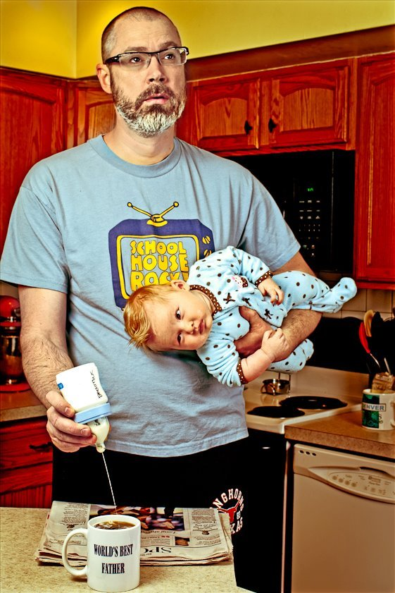
Not so Perfect Dad

Slide 5
Perfect Dad?

Slide 6
Outline
1. The Burden of Parenting
2. Faithfulness Not Success
3. More than Mentors

Slide 7
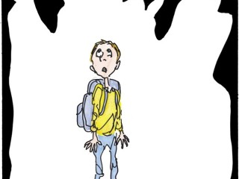
1. The Burden of Parenting
A. The busyness of life
B. The child trap
C. The fear of failure

Slide 8
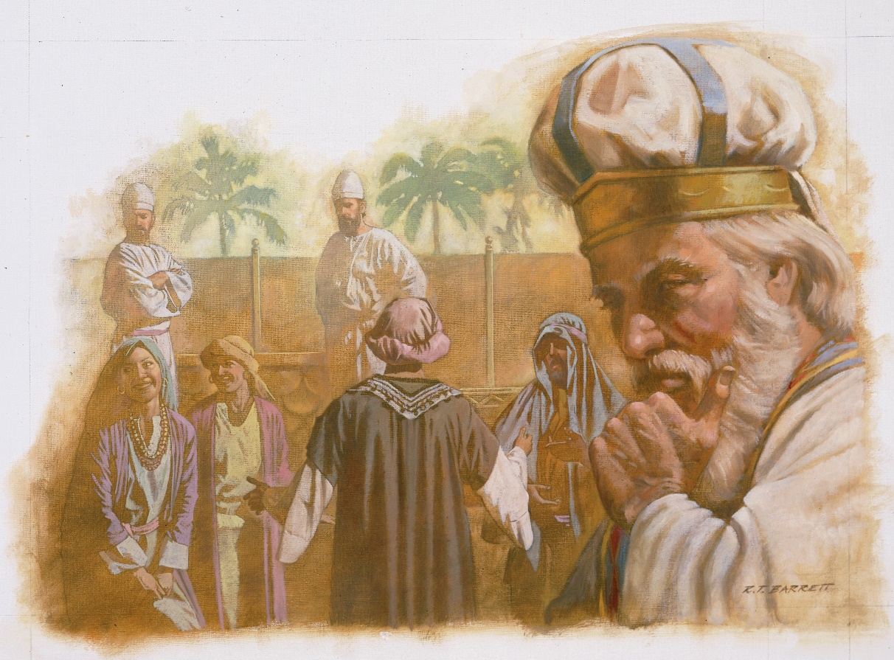
C. The fear of failure
Examples of failed parents:
i. Eli
1 Samuel 2:22-25
22 Now Eli, who was very old, heard about everything
his sons were doing to all Israel and how they slept with the women who served at
the entrance to the tent of meeting. 23 So he said to them, “Why do you do such things?
I hear from all the people about these wicked deeds of yours. 24 No, my sons; the report
I hear spreading among the Lord’s people is not good. 25 If one person sins against another, God may mediate for the offender; but if anyone sins against the Lord, who will intercede for them?” His sons, however, did not listen to their father’s rebuke, for it was the Lord’s will to put them to death.

Slide 9
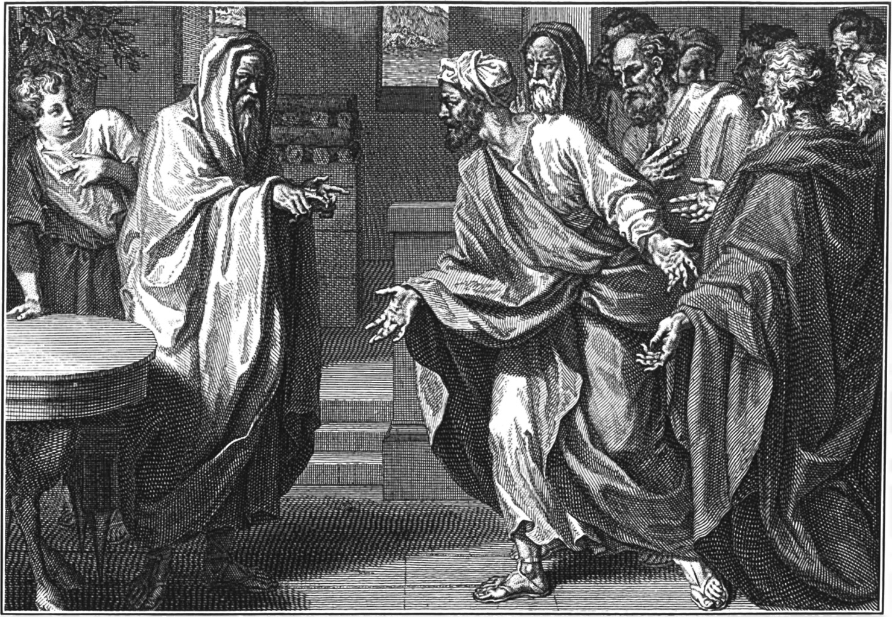
C. The fear of failure
Examples of failed parents:
ii. Samuel
1 Samuel 8:3 But his sons did not
follow his ways. They turned aside
after dishonest gain and accepted
bribes and perverted justice.

Slide 10
X
2. Faithfulness Not Success
Am I parenting faithfully?
Am I parenting successfully?

Slide 11
See example of Ezekiel
Ezekiel 3:4-11
4 He then said to me: “Son of man, go now to the people of Israel and speak my words to them.
5 You are not being sent to a people of obscure speech and strange language, but to the people of Israel— 6 not to many peoples of obscure speech and strange language, whose words you cannot understand. Surely if I had sent you to them, they would have listened to you. 7 But the people of Israel are not willing to listen to you because they are not willing to listen to me, for all the Israelites are hardened and obstinate. 8 But I will make you as unyielding and hardened as they are. 9 I will make your forehead like the hardest stone, harder than flint. Do not be afraid of them or terrified by them, though they are a rebellious people.” 10 And he said to me, “Son of man, listen carefully and take to heart all the words I speak to you. 11 Go now to your people in exile and speak to them. Say to them, ‘This is what the Sovereign Lord says,’ whether they listen
or fail to listen.”

Slide 12
See example of Ezekiel [Ezekiel 3:4-11]
It was uphill at the beginning.
But God mad him stronger.

Slide 13
The Special Place of Faith in the Family
Acts 16:31 They replied, “Believe in the Lord Jesus, and you will be saved—you and your household.”
Genesis 7:1 The Lord then said to Noah, “Go into the ark, you and your whole family, because I have found you righteous in this generation.
Exodus 12:13 The blood will be a sign for you on the houses where you are, and when I see the blood, I will pass over you. No destructive plague will touch you when I strike Egypt.
Joshua 6:17 The city and all that is in it are to be devoted[a] to the Lord. Only Rahab the prostitute and all who are with her in her house shall be spared, because she hid the spies we sent.

Slide 14
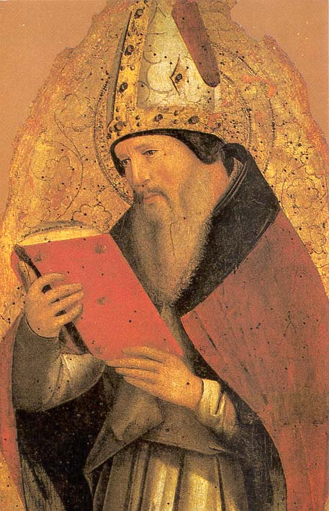
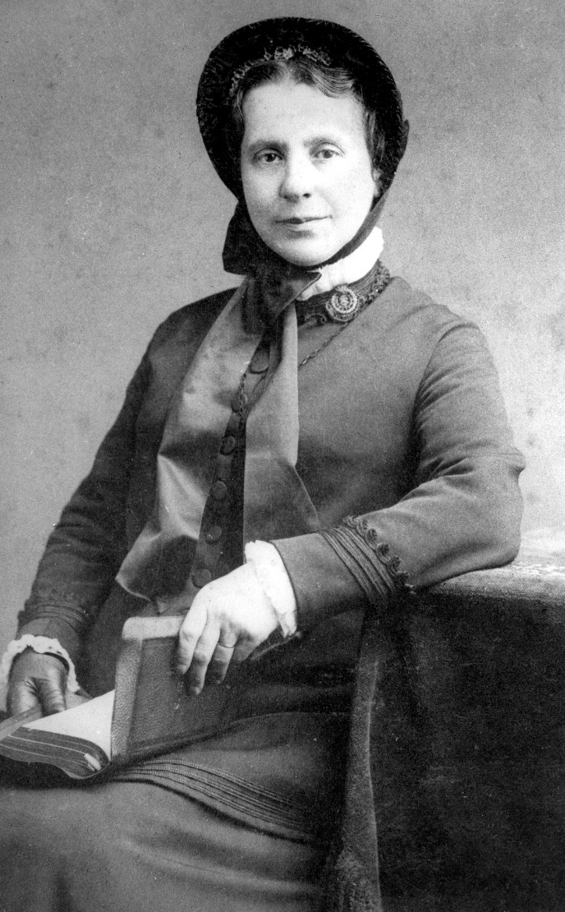
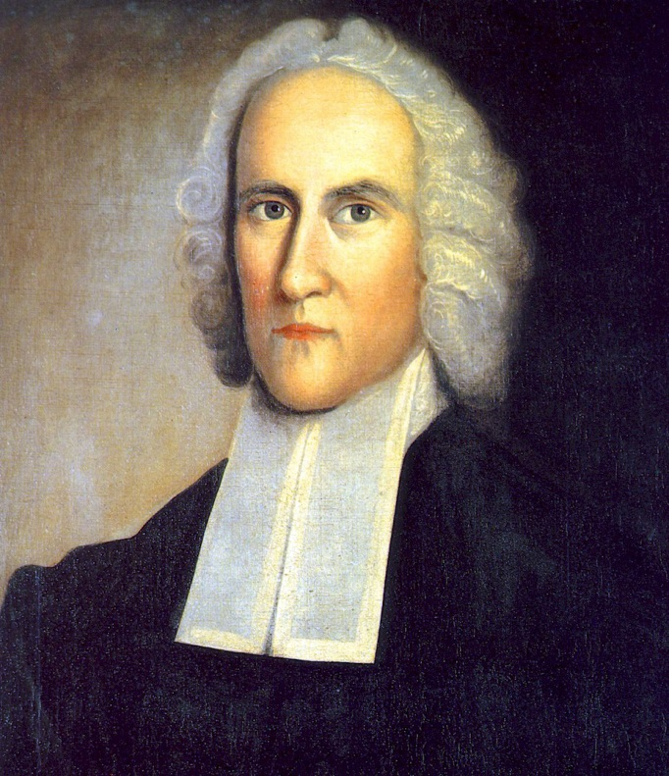
A faithful parent can be the point through which blessings of salvation can be released to the family:
Jonathan Edmonds
St Augustine
Catherine Booth

Slide 15
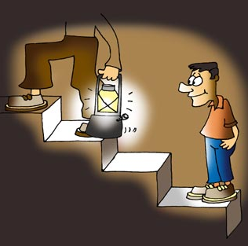
3. More than Mentors
1 Corinthians 4:15 Even if you had ten thousand guardians in Christ, you do not have many fathers, for in Christ Jesus I became your father through the gospel.

Slide 16
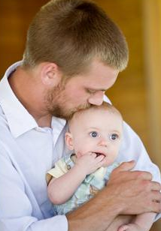
3. More than Mentors
A father blesses
Genesis 1:27-28a
27 So God created mankind in his own image, in the image of God he created them; male and female he created them. 28 God blessed them …

Slide 17
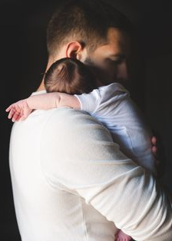
3. More than Mentors
A father loves and protects
James 1:27 Religion that God our Father accepts as pure and faultless is this: to look after orphans and widows in their distress and to keep oneself from being polluted by the world.

Slide 18
3. More than Mentors
A true father is rare

Slide 19
The amazing transforming power of faith in a family
Malachi 4:6 He will turn the hearts of the parents to their children, and the hearts of the children to their parents; or else I will come and strike the land with total destruction.”

Slide 20
Believing Parents praying for Unbelieving Children and Believing Children.
Praying for Unbelieving Parents.

Slide 21
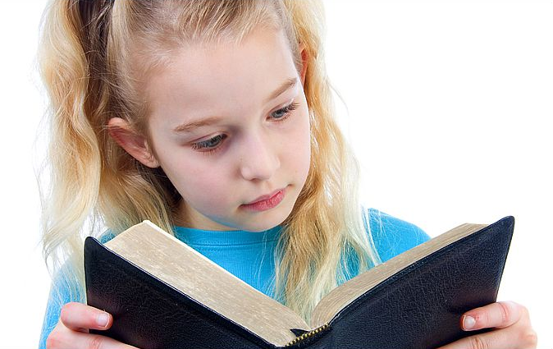
Deuteronomy 6:6-7
6 These commandments that I give you today are to be on your hearts. 7 Impress them on your children. Talk about them when you sit at home and when you walk along the road, when you lie down and when you get up.

Slide 22
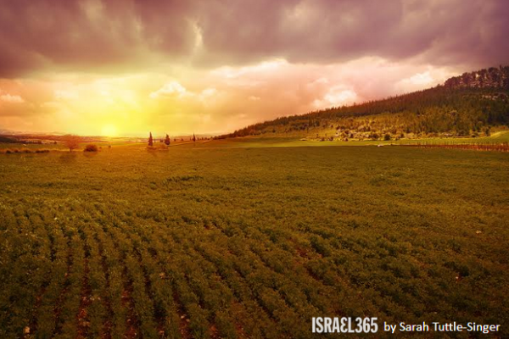
CONCLUSION
Deuteronomy 6:10-11 … and olive groves you did not plant …

Slide 23
CONCLUSION
Deuteronomy 6:11-12
11 houses filled with all kinds of good things you did not provide, wells you did not dig, and vineyards and olive groves you did not plant—then when you eat and are satisfied, 12 be careful that you do not forget the Lord, who brought you out of Egypt, out of the land of slavery.

Slide 24
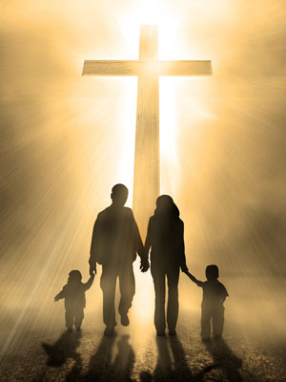
CONCLUSION
Point your family back to God.
Do not try to be the perfect parent but do make it your goal to be a faithful one.
Now is the time to do it!

