Slide 1
CHURCH IS FAMILY

Slide 2
ROMANS 12:9-13
Love must be sincere. Hate what is evil; cling to what is good. Be devoted to one another in love. Honour one another above yourselves. Never be lacking in zeal, but keep your spiritual fervour, serving the Lord. Be joyful in hope, patient in affliction, faithful in prayer. Share with the Lord’s people who are in need. Practice hospitality.
EVERY FAMILY HAS ITS PRESCRIPTIONS.

Slide 3
ROMANS 12:9-13
Love must be sincere. Hate what is evil; cling to what is good. Be devoted to one another in love. Honour one another above yourselves. Never be lacking in zeal, but keep your spiritual fervour, serving the Lord. Be joyful in hope, patient in affliction, faithful in prayer. Share with the Lord’s people who are in need. Practice hospitality.
EVERY FAMILY HAS ITS PRESCRIPTIONS.
WE ABIDE IN PARTNERSHIP WITH JESUS.
THESE ARE THE WAYS OF THE FAMILY OF GOD.
HEBREWS 2:11 Both the one who makes people holy and those who are made holy are of the same family. So Jesus is not ashamed to call them brothers and sisters.
ROMANS 8:29b … that Jesus might be the firstborn among many brothers and sisters.
MARK 3:35 “For whoever does the will of God, he is My brother and sister and mother.”

Slide 4
WHAT DOES IT MEAN TO BE A BBTCIAN?
1 BBTCians are convicted by the Gospel of Good News!
2 BBTCians choose to love & live by the Word of God.
3 BBTCians crave continuous encounters with and empowerment by the Holy Spirit.
4 BBTCians are conscious to live out the Great Commission to save souls. We share Christ!
5 BBTCians are committed to discipleship in the body-life (Hebrews 10:24-25).

Slide 5
ROMANS 12:14-19
Bless those who persecute you; bless and do not curse. Rejoice with those who rejoice; mourn with those who mourn. Live in harmony with one another. Do not be proud, but be willing to associate with people of low position. Do not be conceited. Do not repay anyone evil for evil. Do what is right in the eyes of everyone. If it is possible, as far as it depends on you, live at peace with everyone. Do not take revenge, my dear friends, but leave room for God’s wrath, for it is written: “It is mine to avenge; I will repay,” says the Lord.
EVERY FAMILY HAS ITS FRICTIONS.
WE RESPOND AS PEACEMAKERS LIKE JESUS.
THIS SHOWS THE WARMTH OF THE FAMILY OF GOD.
MATTHEW 5:9
Blessed are the peacemakers, for they shall be called the children of God.

Slide 6
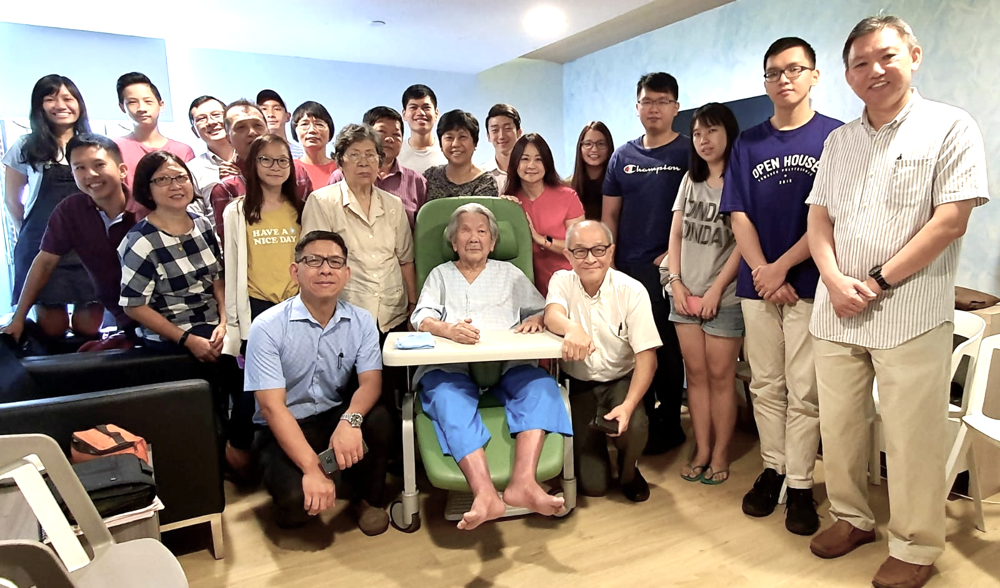
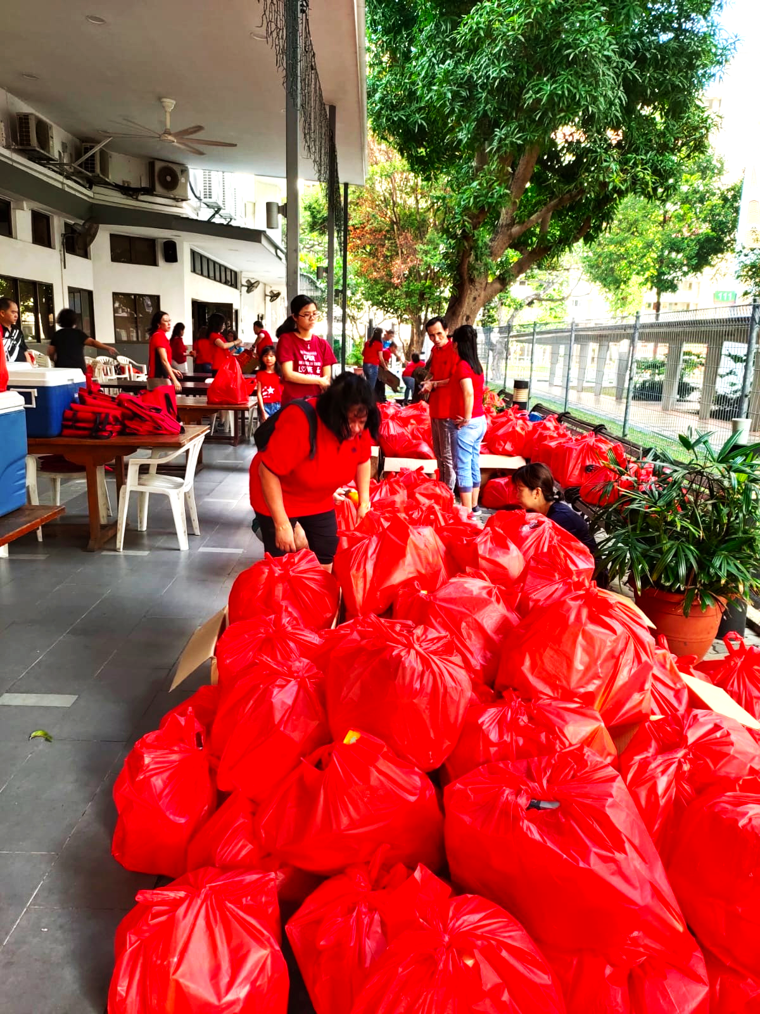
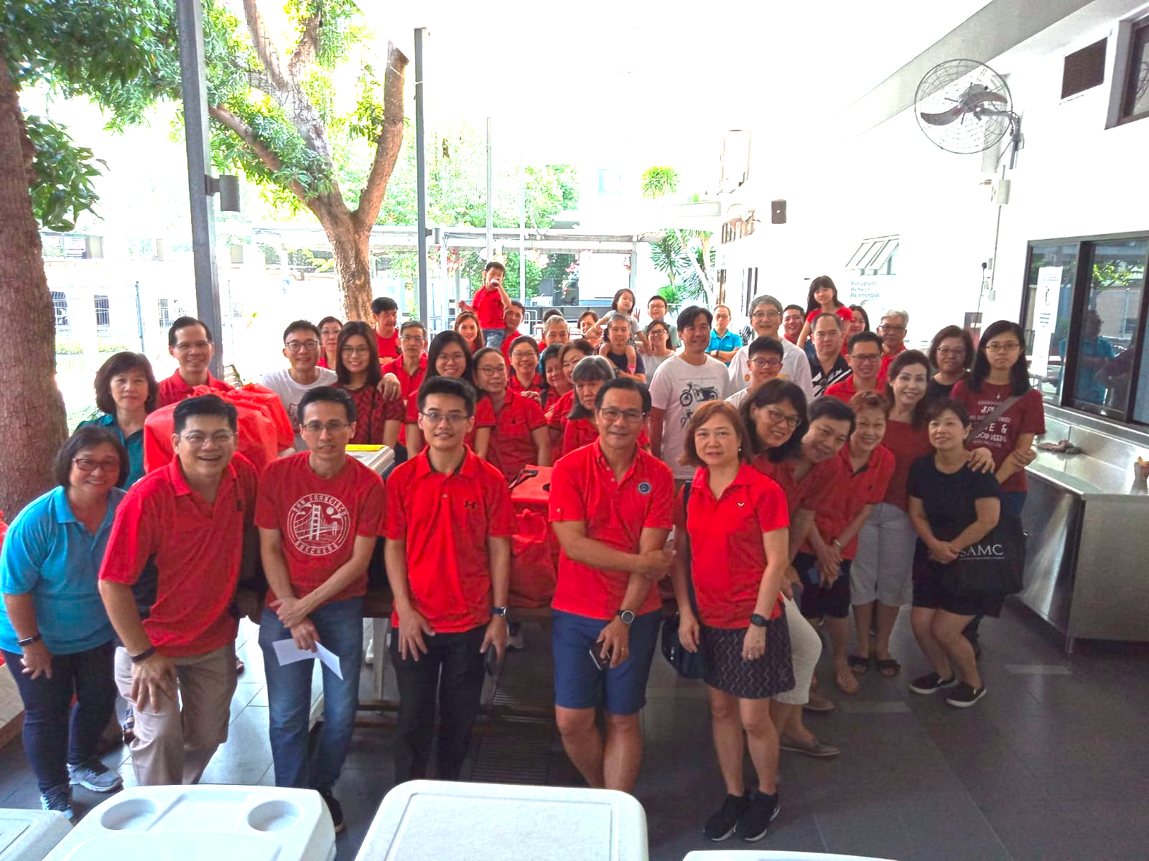
ROMANS 12:20-21
On the contrary: “If your enemy is hungry, feed him; if he is thirsty, give him something to drink. In doing this, you will heap burning coals on his head.” Do not be overcome by evil, but overcome evil with good.

Slide 7
EVERY FAMILY HAS ITS MISSION/COMMISSION.
ROMANS 12:20-21
On the contrary: “If your enemy is hungry, feed him; if he is thirsty, give him something to drink. In doing this, you will heap burning coals on his head.” Do not be overcome by evil, but overcome evil with good.
LUKE 17:20-21
Jesus replied, “The coming of the kingdom of God is not something that can be observed, nor will people say, ‘Here it is,’ or ‘There it is,’ because the kingdom of God is in your midst (footnote: or, within you).”

Slide 8
EVERY FAMILY HAS ITS MISSION/COMMISSION.
ROMANS 12:20-21
On the contrary: “If your enemy is hungry, feed him; if he is thirsty, give him something to drink. In doing this, you will heap burning coals on his head.” Do not be overcome by evil, but overcome evil with good.
413
SALVATIONS
156
BAPTISMS
688
VISITORS

Slide 9
EVERY FAMILY HAS ITS MISSION/COMMISSION.
ROMANS 12:20-21
On the contrary: “If your enemy is hungry, feed him; if he is thirsty, give him something to drink. In doing this, you will heap burning coals on his head.” Do not be overcome by evil, but overcome evil with good.
413
SALVATIONS
156
BAPTISMS
688
VISITORS

Slide 10
EVERY FAMILY HAS ITS MISSION/COMMISSION.
WE ARE PURPOSE-DRIVEN LIKE JESUS.
THIS IS THE WITNESS OF THE FAMILY OF GOD.
ROMANS 12:20-21
On the contrary: “If your enemy is hungry, feed him; if he is thirsty, give him something to drink. In doing this, you will heap burning coals on his head.” Do not be overcome by evil, but overcome evil with good.

Slide 11
EVERY FAMILY HAS ITS MISSION/COMMISSION.
WE ARE PURPOSE-DRIVEN LIKE JESUS.
THIS IS THE WITNESS OF THE FAMILY OF GOD.
ROMANS 12:20-21
On the contrary: “If your enemy is hungry, feed him; if he is thirsty, give him something to drink. In doing this, you will heap burning coals on his head.” Do not be overcome by evil, but overcome evil with good.

Slide 12
EVERY FAMILY HAS ITS PRESCRIPTIONS.
WE ABIDE IN PARTNERSHIP WITH JESUS.
THESE ARE THE WAYS OF THE FAMILY OF GOD.
EVERY FAMILY HAS ITS FRICTIONS.
WE RESPOND AS PEACEMAKERS LIKE JESUS.
THIS SHOWS THE WARMTH OF THE FAMILY OF GOD.
EVERY FAMILY HAS ITS MISSION/COMMISSION.
WE ARE PURPOSE-DRIVEN LIKE JESUS.
THIS IS THE WITNESS OF THE FAMILY OF GOD.

Slide 13
CHURCH IS FAMILY.
THIS IS OUR FAMILY.

