Slide 6
Mark 3:14-15
14 Then He appointed twelve, that they might be with Him and that He might send them out to preach, 15 and to have power to heal sicknesses and to cast out demons …

Slide 7
The Lord Jesus called the disciples to:
1. Be with Him - build relationship with God
2. Share the Gospel
3. Have power to heal the sick
4. Have power to cast out demons
Priestly & Kingly Functions
The Disciple is a Priest & King
Heart of Discipleship-DNA of BBTC
End-Time Harvest-Increased Demonic Activities
P & K Thrive-not survive

Slide 8
Question:
Why is the NT believer only a P&K and not a Prophet?

Slide 9
Question: Why is the NT believer only a P&K and not a Prophet?
1. Because the Bible says so [Revelation 1:5-6; 1 Peter 2:9; Revelation 5:10]
2. Prophecy = forth-telling and / or fore-telling

Slide 10
Question: Why is the NT believer only a P&K and not a Prophet?
3. Ephesians 4:11 - 5-Fold Office to equip Body
There are still prophets as there are still evangelists
Every believer to evangelize, but not every believer holds the Office of an Evangelist
Every believer to testify of Jesus (Spirit of Prophecy-Speak Forth the Rhema Word), but not hold the Office of a Prophet
General Ministry (every believer) - Special Gifting (some) - Office (EG:B.Graham; R.Bonnke; JJohnson; JCahn)

Slide 11
Question: Why is the NT believer only a P&K and not a Prophet?
4. Nature of Prophecy changed since Pentecost
Every believer has indwelling Holy Spirit
Every believer can speak forth the Word
Every prophecy must be weighed-tested

Slide 12
I. WHY a disciple is a Priest & King?
II. WHAT does it mean for a disciple to be a Priest?
III. WHAT does it mean for a disciple to be a King?
IV. HOW to be a Priest & King in reaching out to the Lost?
V. HOW to be a Priest & King to heal, cast out demons and take authority?
PART 2
PART 3
PART 4

Slide 13
I. WHY a disciple is a Priest & King?
II. WHAT does it mean for a disciple to be a Priest?
III. WHAT does it mean for a disciple to be a King?
IV. HOW to be a Priest & King in reaching out to the Lost?
V. HOW to be a Priest & King to heal, cast out demons and take authority?

Slide 15
Share The Gospel
How to reach out to the lost?
Pre-believers
Backslidden ones

Slide 16
The Lord has given us 2 keys to reach out to the lost:
1. Relational Evangelism
2. Strategic Prayers

Slide 17
The Lord has given us 2 keys to reach out to the lost:
1. Relational Evangelism
2. Strategic Prayers

Slide 18
Luke 10:5-9
5 But whatever house you enter, first say, ‘Peace to this house.’ 6 And if a son of peace is there, your peace will rest on it; if not, it will return to you. 7 And remain in the same house, eating and drinking such things as they give, for the labourer is worthy of his wages. Do not go from house to house. 8 Whatever city you enter, and they receive you, eat such things as are set before you. 9 And heal the sick there, and say to them, ‘The kingdom of God has come near to you.’

Slide 19
1. Relational Evangelism
A. Find a man of peace and bless him with the Peace of God.
Luke 10:6 And if a son of peace is there, your peace will rest on it; if not, it will return to you.
The man of peace is the person who is receptive to you
Therefore, amongst the people you are reaching out, channel your energies towards those who are receptive to you (Man of Peace).
Notes:
HOW TO PRAY FOR THEM EVERYDAY?
MAKE MENTION OF THE NAMES BEFORE GOD
DO NOT GIVE UP AND KEEP ON PRESSING

Slide 20
The Lord has given us 2 keys to reach out to the lost:
1. Relational Evangelism
B. Fellowship with them - eat and drink with them.
Luke 10:7 And remain in the same house, eating and drinking such things as they give, for the labourer is worthy of his wages. Do not go from house to house.
Focus-Intentional to win them
S&L-J-Ng’sDad
J’s Mom & Sis
TL’sDad

Slide 21
The Lord has given us 2 keys to reach out to the lost:
1. Relational Evangelism
C. Meet their felt needs (minister as priests & kings)
Luke 10:1-9 And heal the sick there … (Part 4)
His father hospitalised
A family situation
COVID19+
His marriage
Financial Issues
Accident
Work difficulty
Children’s problems in school
When he is not well
1 Corinthians 2:4-5
SACH-FWs
Notes:
TO FIND OPPORTUNITY TO COME ALONG WITH THEM TO MEET THEIR FELT NEEDS AND AVAIL YOURSELF - THIS IS EXPRESSION OF LOVE

Slide 22
This is Power Evangelism
Luke 4:18 The Spirit of the Lord is upon Me, because He has anointed Me to preach the gospel to the poor; He has sent Me to heal the broken-hearted, to proclaim liberty to the captives and recovery of sight to the blind, to set at liberty those who are oppressed …
Notes:
10 OUT OF 10 WILL FACE THE PROBLEM COS WE ARE LIVING IN THE FALLEN WORLD – PROBLEM IN THE FAMILY, STRESS, QUARREL WITH NEIGHBOUR, ETC.
ASK GOD TO ANOINT AND FOCUS WHAT HE WANTS TO SEE
GOD IS LOOKING FOR A MAN AND A WOMAN WHO IS PARTNER WITH HIM SO THAT HE CAN DEMONSTRATE AND EXPAND HIS LOVE AND HIS GRACE TO HIS PEOPLE AND CHURCH
NO CONDEMNATION, COMPARISON NOR COMPETION BUT ALWAYS ENCOURAGEMENT

Slide 23
This is Power Evangelism
Mark 16:15, 17-18, 20
15 And He said to them, “Go into all the world and preach the gospel to every creature … 17 And these signs will follow those who believe: In My name they will cast out demons; … 18 … they will lay hands on the sick, and they will recover.” 20 And they went out and preached everywhere, the Lord working with them and confirming the word through the accompanying signs. Amen.

Slide 24
The Lord has given us 2 keys to reach out to the lost:
1. Relational Evangelism
D. Share the Gospel of the Kingdom of God.
Luke 10:9b and say to them, ‘The kingdom of God has come near to you.’
Notes:
THIS IS THE LAST THING TO DO IS TO SHARE THE GOSPEL
WE ARE ALWAYS COME BACK TO THE CROSS – TEARING DOWN STRONGHOLD AND WON THE VICTOR’S CROWN AND HIS BLOOD IS VERY POWERFUL

Slide 25
The Lord has given us 2 keys to reach out to the lost:
1. Relational Evangelism
2. Strategic Prayers

Slide 26
2. Praying Strategic Prayers
Pray before, during and after every meeting / engagement

Slide 27
2. Praying Strategic Prayers
A. Know and understand their barriers- objections in coming to the Lord. They are ungodly beliefs (UGBs).
B. Know the truth in the Word of God.
C. Pray as a Priest.
D. As a King, rebuke the specific lies and the deceiving demonic spirits.

Slide 28
2. Praying Strategic Prayers
A. Know and understand their barriers-objections in coming to the Lord. They are ungodly beliefs (UGBs).
2 Corinthians 4:3-4
3 But even if our gospel is veiled, it is veiled to those who are perishing, whose minds the god of this age has blinded, who do not believe, lest the light of the gospel of the glory of Christ, who is the image of God, should shine on them.
Notes:
THEY ARE SPIRITUAL BLINDED COS DEVIL IS THE DECEIVER
95% TRUTH AND HE PUT 5% DECEPTION

Slide 29
2. Praying Strategic Prayers
B. Know the truth in the Word of God.
John 8:32 And you shall know the truth, and the truth shall make you free.”
2 Cor 10:5-Pray-Declare-Say-Sing what Word says vs lies/UGBs-feelings!
Notes:
AS A DISCIPLE, WE CANNOT BE IGNORANCE

Slide 30
Video

Slide 33
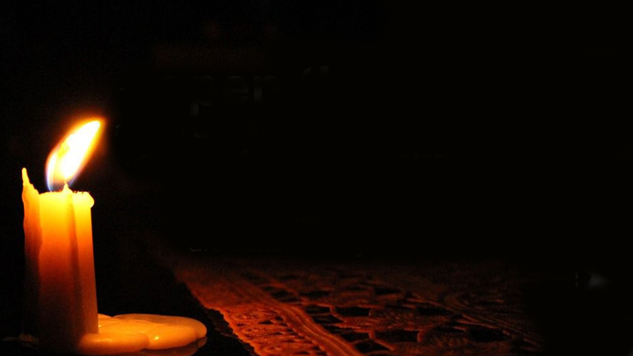
2. Praying Strategic Prayers
C. Pray as a Priest.
Acts 26:18 to open their eyes, in order to turn them from darkness to light, and from the power of Satan to God, that they may receive forgiveness of sins and an inheritance among those who are sanctified by faith in Me.
EC-dad
Notes:
PRAY WITH ACTS 26:18 AS YOUR AIM.
PRAY SPECIFIC PRAYERS
EVERYTHING IN LIFE IS INTENTIONAL

Slide 34
2. Praying Strategic Prayers
D. As a King, rebuke the specific lies and the deceiving demonic spirits.
2 Corinthians 10:4-5
4 For the weapons of our warfare are not carnal but mighty in God for pulling down strongholds, 5 casting down arguments and every high thing that exalts itself against the knowledge of God, bringing every thought into captivity to the obedience of Christ.
Notes:
E.G. WAR ROOM
SUBMIT TO GOD IS TO PRAY AS A PRIEST
RESIST THE DEVIL IS TO ACT AS KING
REBUKE THE DEVIL – HOW?
IMAGINE DEVIL IS LIKE THE BIRD FLYING ABOVE THE HEAD – HOW?
SPEAK FORTH OF YOUR MOUTH WITH AUTHORITY AND IN FAITH AND HASHLY – AUTHORITY IS IN JESUS’ NAME
3 SPIRITUAL WEAPONS – NAME OF JESUS, BLOOD OF JESUS AND SWORD OF THE SPIRIT (WORD OF GOD)

Slide 35
2. Praying Strategic Prayers - Summary:
A. Know and understand their barriers-objections in coming to the Lord. They are ungodly beliefs (UGBs).
B. Know the truth in the Word of God.
C. Pray as a Priest.
D. As a King, rebuke the specific lies and the deceiving demonic spirits.

Slide 36
Sample Strategic Prayer (Priestly)
Lord, we pray for ___ that the light of Your truth will shine into his heart.
We ask of You to dismantle the lies that (state the UGBs).
Lord, will You open the eyes of ___ to see and know the (the Truths countering the UGBs).
We ask of You Holy Spirit to lead ___ to know the Truth and be set free from these lies and to come to the saving grace and knowledge of the Lord Jesus Christ.

Slide 37
Sample Strategic Prayer (Kingly)
In Jesus’ name, we demolish the argument lodged in ___ life, that (state the UGBs).
In Jesus’ name, we come against the lying and deceptive spirits operating in ___’s life.
In Jesus’ name, we tear down these demonic strongholds in ___ life and speak the light of the Gospel of Jesus Christ to shine in ___’s heart and mind to come to the saving grace and knowledge of our Lord Jesus Christ!
We pray this in Jesus’ Mighty Name, Amen.

Slide 38
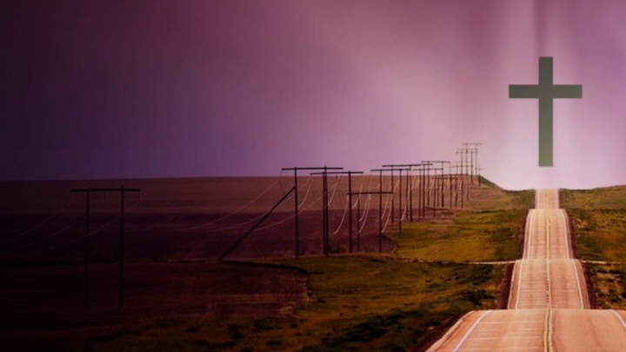
UGB #1 - All religions and philosophies are the same.
The Truth: What does the Bible say?
John 14:6 Jesus said to him, “I am the way, the truth, and the life. No one comes to the Father except through Me.
Acts 4:12 Nor is there salvation in any other, for there is no other name under heaven given among men by which we must be saved.
dad

Slide 39
Strategic Prayer (Priestly)
Lord, we pray for ___ that the light of Your truth will shine into his heart.
We ask of You to dismantle the lies that “all religions and philosophies are the same leading to God” (UGBs).
Lord, will You open the eyes of ___ to see and know the significant differences of each religion and philosophy (the Truth).
We ask of You Holy Spirit to lead ___ to know the Truth and be set free from these lies and to come to the saving grace and knowledge of the Lord Jesus Christ.

Slide 40
Strategic Prayer (Kingly)
In Jesus’ name, we demolish the argument lodged in ___ life, that all religions and philosophies are the same (UGBs).
In Jesus’ name, we come against the lying and deceptive spirits operating in ___’s life.
In Jesus’ name, we tear down these demonic strongholds in ___ life and speak the light of the Gospel of Jesus Christ to shine in ___’s heart and mind to come to the saving grace and knowledge of our Lord Jesus Christ!
We pray this in Jesus’ Mighty Name, Amen.

Slide 41
UGB #2 - Money will solve all problems. There is no need for God.
The Truth: What does the Bible say?
Mark 8:36-37 36 For what will it profit a man if he gains the whole world, and loses his own soul? 37 Or what will a man give in exchange for his soul?
dad

Slide 42
UGB #2 - Money will solve all problems. There is no need for God.
The Truth: What does the Bible say?
Luke 12:20-21 20 But God said to him, ‘Fool! This night your soul will be required of you; then whose will those things be which you have provided?’ 21 “So is he who lays up treasure for himself, and is not rich toward God.”
dad

Slide 43
Strategic Prayer (Priestly)
Lord, we pray for ___ that the light of Your truth will shine into his heart.
We ask of You to dismantle the lies that “money will solve all problems” (UGBs).
Lord, will You open the eyes of ___ to see and know the truth that money can never buy health, true friendships or peace in our hearts and minds. And that we will leave all our monies behind when we die (the Truth).
We ask of You Holy Spirit to lead ___ to know the Truth and be set free from these lies and to come to the saving grace and knowledge of the Lord Jesus Christ.

Slide 44
Strategic Prayer (Kingly)
In Jesus’ name, we demolish the argument lodged in ___ life, that “money will solve all problems” (UGBs).
In Jesus’ name, we come against the lying and deceptive spirits operating in ___’s life.
In Jesus’ name, we tear down these demonic strongholds in ___ life and speak the light of the Gospel of Jesus Christ to shine in ___’s heart and mind to come to the saving grace and knowledge of our Lord Jesus Christ!
We pray this in Jesus’ Mighty Name, Amen.

Slide 45
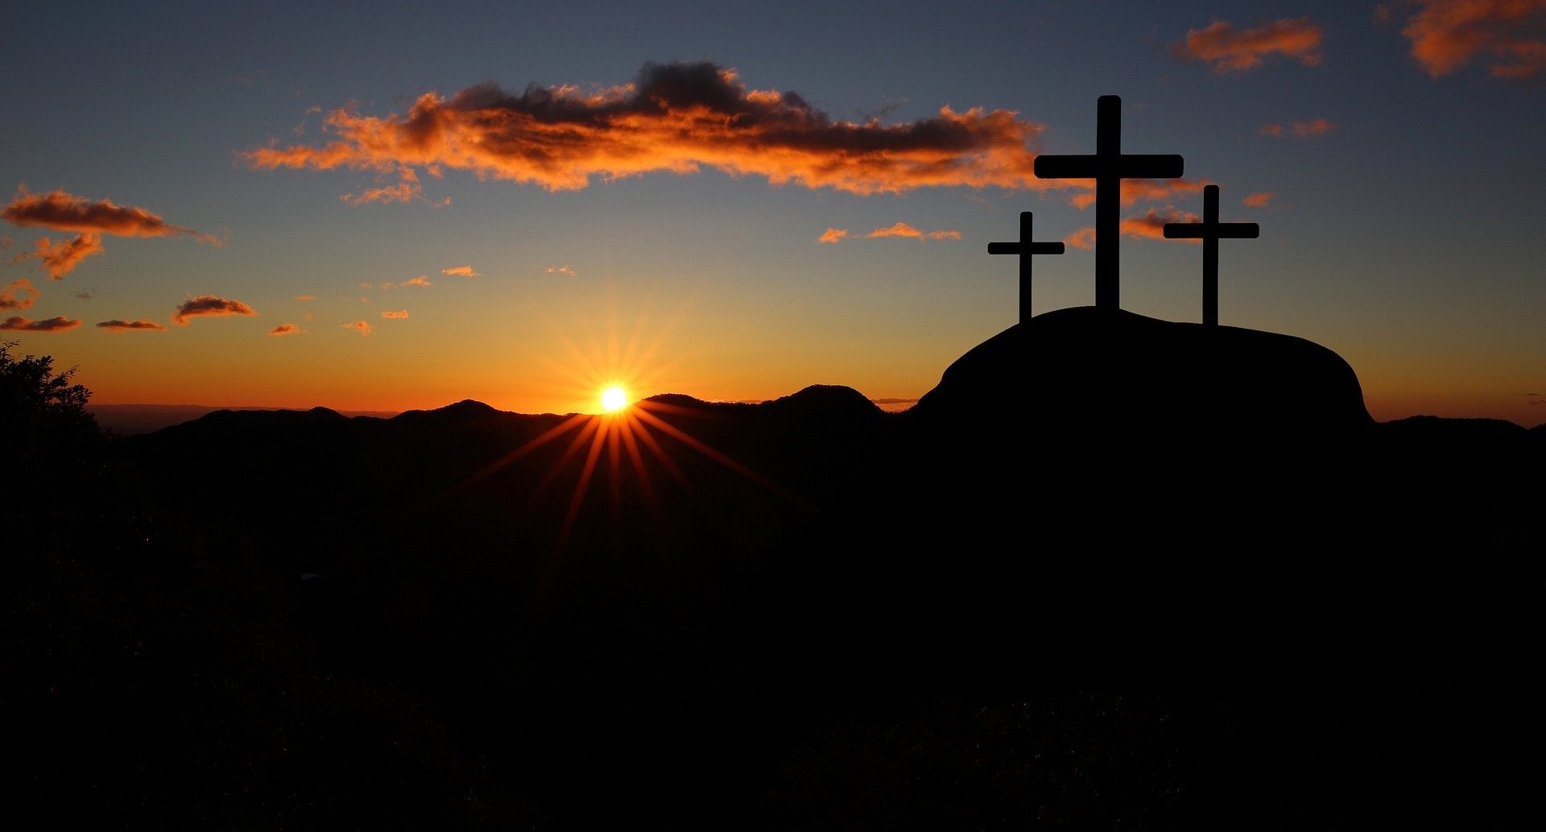
UGB #3 - I’ve been offended by Christians who are hypocrites.
The Truth: What does the Bible say?
Romans 3:10, 23
10 As it is written: There is none righteous, no, not one …
23 for all have sinned and fall short of the glory of God …

Slide 46
Strategic Prayer (Priestly)
Lord, we pray for ___ that the light of Your truth will shine into his heart.
We ask of You to dismantle the lie that “Christians are hypocrites” (UGBs).
Lord, will You open the eyes of ___ to see and know that we are all fallen people, that there is none righteous including all so-called Christians, that we all offend and hurt each other, that we all need Your love, deliverance and healing (the Truth).

Slide 47
Strategic Prayer (Priestly)
Lord, will You heal his heart from the specific offence of the Christians who have stumbled him. Help him to see his own need for You.
We ask of You Holy Spirit to lead ___ to know the Truth and be set free from these lies and to come to the saving grace and knowledge of the Lord Jesus Christ.

Slide 48
Strategic Prayer (Kingly)
In Jesus’ name, we demolish the argument lodged in ___ life, that “Christians are hypocrites” (UGBs).”
In Jesus’ name, we come against the lying and deceptive spirits operating in ___’s life.
In Jesus’ name, we tear down these demonic strongholds in ____ life and speak the light of the Gospel of Jesus Christ to shine in ___’s heart and mind to come to the saving grace and knowledge of our Lord Jesus Christ!
We pray this in Jesus’ Mighty Name, Amen.

Slide 49
UGB #4 - Christianity is for the westerners.
The Truth: What does the Bible say?
John 3:16 For God so loved the world that He gave His only begotten Son, that whoever believes in Him should not perish but have everlasting life.
dad

Slide 50
UGB #4 - Christianity is for the westerners.
The Truth: What does the Bible say?
2 Peter 3:9 The Lord is not slack concerning His promise, as some count slackness, but is longsuffering toward us, not willing that any should perish but that all should come to repentance.
Notes:
THE HEART OF GOD IS FOR EVERYONE TO BE SAVED

Slide 51
Strategic Prayer (Priestly)
Lord, we pray for ___ that the light of Your truth will shine into his heart.
We ask of You to dismantle the lie that “Christianity is for the westerners” (UGBs).
Lord, will You open the eyes of ___ to see and know that Your truth is universal and Your love reaches out to all people regardless of race, language, status and background (the Truth).
We ask of You Holy Spirit to lead ___ to know the Truth and be set free from these lies and to come to the saving grace and knowledge of the Lord Jesus Christ.

Slide 52
Strategic Prayer (Kingly)
In Jesus’ name, we demolish the argument lodged in ____ life, that “Christianity is for the westerners” (UGBs).”
In Jesus’ name, we come against the lying and deceptive spirits operating in ___’s life.
In Jesus’ name, we tear down these demonic strongholds in ___ life and speak the light of the Gospel of Jesus Christ to shine in ___’s heart and mind to come to the saving grace and knowledge of our Lord Jesus Christ!
We pray this in Jesus’ Mighty Name, Amen.

Slide 53
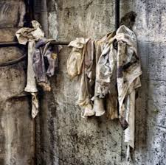
UGB #5 - Good works are good enough for salvation.
The Truth: What does the Bible say?
Isaiah 64:6 But we are all like an unclean thing, and all our righteousness are like filthy rags; We all fade as a leaf, and our inequities, like the wind, have taken us away.

Slide 54
UGB #5 - Good works are good enough for salvation.
The Truth: What does the Bible say?
Ephesians 2:8-9
8 For by grace you have been saved through faith, and that not of yourselves; it is the gift of God, 9 not of works, lest anyone should boast.

Slide 55
Strategic Prayer (Priestly)
Lord, we pray for ___ that the light of Your truth will shine into his heart.
We ask of You to dismantle the lie that “Good works are good enough for salvation” (UGBs). Lord, will You open the eyes of ___ to know that all have sinned and fall short of Your glory; and to know that salvation is a gift from You and not something we can earn by our own works (the Truth).
We ask of You Holy Spirit to lead ___ to know the Truth and be set free from these lies and to come to the saving grace and knowledge of the Lord Jesus Christ.

Slide 56
Strategic Prayer (Kingly)
In Jesus’ name, we demolish the argument lodged in ___ life, that “Good works are good enough for salvation” (UGBs).”
In Jesus’ name, we come against the lying and deceptive spirits operating in ___’s life.
In Jesus’ name, we tear down these demonic strongholds in ___ life and speak the light of the Gospel of Jesus Christ to shine in ___’s heart and mind to come to the saving grace and knowledge of our Lord Jesus Christ!
We pray this in Jesus’ Mighty Name, Amen.

Slide 57
UGB #6 - If I become a Christian, who is going to pray and offer food to my departed loved ones?
UGB #7 - I had promised my relatives to observe prayers and provide offerings to them after their departure. It will be un-filial to stop doing so.
UGB #8 - I have bought a niche and would want to have it placed by the side of my late spouse. If I accept Jesus, then I couldn’t be with my late spouse.
Han

Slide 58
The Truth: What does the Bible say?
Luke 16:22-23, 26, 28-29
22 So it was that the beggar died, and was carried by the angels to Abraham’s bosom. The rich man also died and was buried. 23 And being in torments in Hades, he lifted up his eyes and saw Abraham afar off, and Lazarus in his bosom.
Notes:
SALVATION IS BASED ON A REVELATION OF GOD
ROM 1 TO 3 – GOD SPEAKS TO THEM THROUGH CREATION
PSALM
ACT 17
ROM 9:12 – CONSCIENCE
ECC 3:16 In the place of judgment, Wickedness was there; and in the place of righteousness, iniquity was there.
JUDGMENT WILL COME ACCORDING TO SPECIFIC RESPOND TO THE REVELATION TO GOD
GOD REVEALS HIMSELF TO MAN ALL THE TIME

Slide 59
The Truth: What does the Bible say?
Luke 16:22-23, 26, 28-29
26 And besides all this, between us and you there is a great gulf fixed, so that those who want to pass from here to you cannot, nor can those from there pass to us.’
Han
Notes:
SALVATION IS BASED ON A REVELATION OF GOD
ROM 1 TO 3 – GOD SPEAKS TO THEM THROUGH CREATION
PSALM
ACT 17
ROM 9:12 – CONSCIENCE
ECC 3:16 In the place of judgment, Wickedness was there; and in the place of righteousness, iniquity was there.
JUDGMENT WILL COME ACCORDING TO SPECIFIC RESPOND TO THE REVELATION TO GOD

Slide 60
The Truth: What does the Bible say?
Luke 16:22-23, 26, 28-29
28 for I have five brothers, that he may testify to them, lest they also come to this place of torment.’ 29 Abraham said to him, ‘They have Moses and the prophets; let them hear them.’
Han
Notes:
SALVATION IS BASED ON A REVELATION OF GOD
ROM 1 TO 3 – GOD SPEAKS TO THEM THROUGH CREATION
PSALM
ACT 17
ROM 9:12 – CONSCIENCE
ECC 3:16 In the place of judgment, Wickedness was there; and in the place of righteousness, iniquity was there.
JUDGMENT WILL COME ACCORDING TO SPECIFIC RESPOND TO THE REVELATION TO GOD

Slide 61
Strategic Prayer (Priestly)
Lord, we pray for ___ that the light of Your truth will shine into his heart.
We ask of You to dismantle the lies: - that “offerings to our departed loved ones will do anything for them” (UGBs) - it is un-filial to stop praying to the dead (UGBs)
- you can be with departed loved-ones (UGBs)

Slide 62
Strategic Prayer (Priestly)
Lord, will You open the eyes of ___ to see and know that the separation between the living and the dead is permanent, and there is no possibility of any connection between the two (the Truth).
We ask of you to also help them know that their loved ones desire for them to know the Lord and not be in Hades. (Luke16:28)
We ask of You Holy Spirit to lead ___ to know the Truth and be set free from these lies and to come to the saving grace and knowledge of the Lord Jesus Christ.

Slide 63
Strategic Prayer (Kingly)
In Jesus’ name, we demolish the argument lodged in ___ life, that “we can connect with our departed loved ones” (UGBs).
In Jesus’ name, we come against the lying and deceptive spirits operating in ___’s life.
In Jesus’ name, we tear down these demonic strongholds in ___ life and speak the light of the Gospel of Jesus Christ to shine in ___’s heart and mind to come to the saving grace and knowledge of our Lord Jesus Christ!
We pray this in Jesus’ Mighty Name, Amen.

Slide 64
The Lord has given us 2 keys to reach out to the lost:
1. Relational Evangelism
2. Strategic Prayers

Slide 65
End-Times Harvest of Souls
Phase 1 - Up to Rapture
Mark 16:15 And He said to them, “Go into all the world and preach the gospel to every creature.
Dan 12:3

Slide 66
End-Times Harvest of Souls
Phase 2 - During 1st 3 ½ years by 144K Jewish Evangelists
Revelation 7:9 After these things I looked, and behold, a great multitude which no one could number, of all nations, tribes, peoples, and tongues …

Slide 67
End-Times Harvest of Souls
Phase 3 - By the 2 Angels in 2nd half of Tribulation
Revelation 14:6 Then I saw another angel flying in the midst of heaven, having the everlasting gospel to preach to those who dwell on the earth—to every nation, tribe, tongue, and people—

