Slide 1
12th July Sunday

Slide 2
Welcome Back!

Slide 3
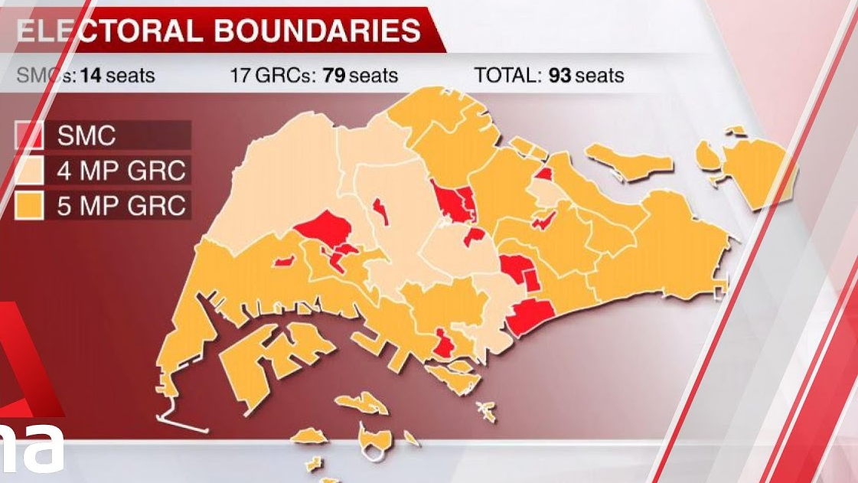
2020 SINGAPORE GENERAL ELECTION

Slide 5
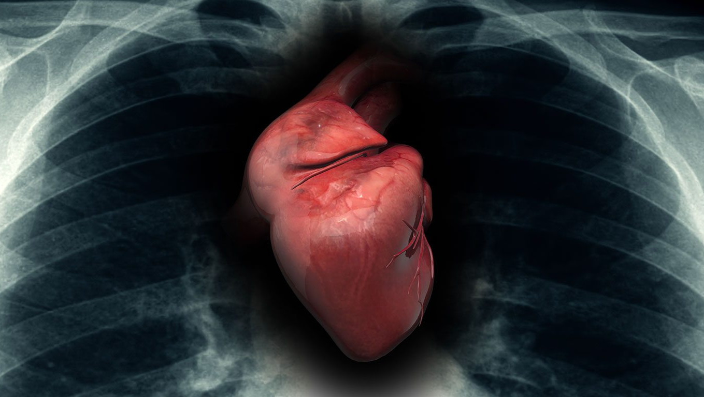
JEREMIAH 17:9
The heart is more deceitful than all else
And is desperately sick;
Who can understand it?

Slide 6
FOOLPROOF
FOOLPROOF
OUR FAITH
OUR FAITH

Slide 7
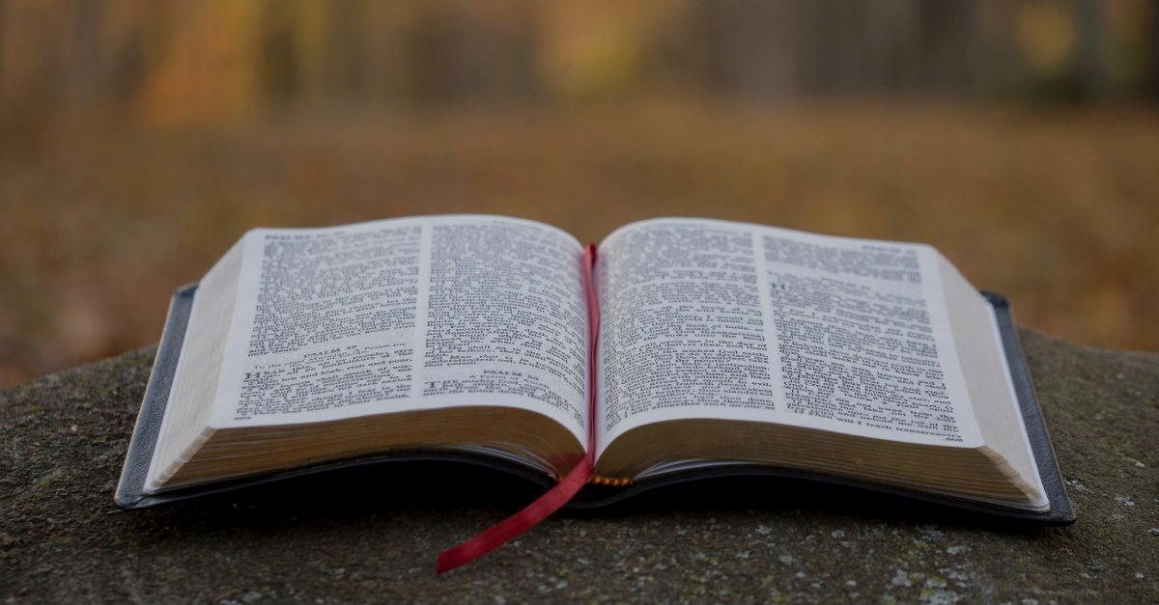
PSALM 14 & PSALM 53
* Written btw 1 Chron 11 & 15

Slide 8
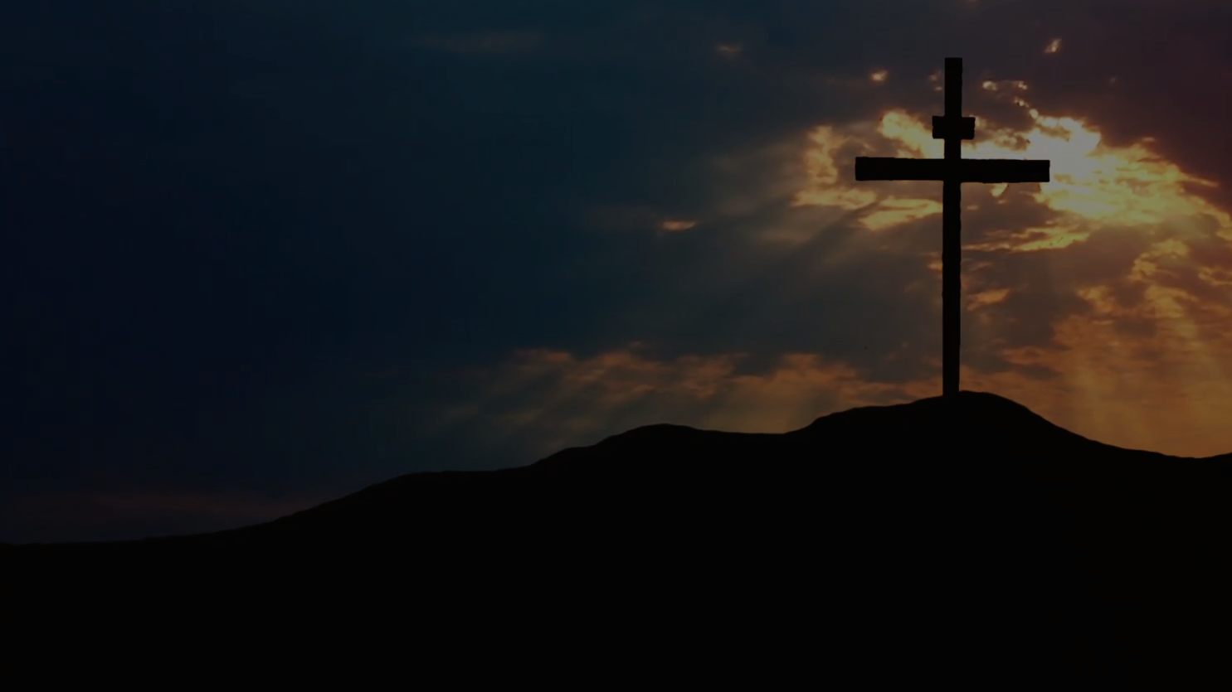
PSALM 14
¹The fool has said in his heart, “There is no God.” They are corrupt, they have committed abominable deeds; There is no one who does good.”
² The Lord has looked down from heaven upon the sons of men To see if there are any who understand, Who seek after God.
³ They have all turned aside, together they have become corrupt; There is no one who does good, not even one.

Slide 9
PSALM 14
⁴ Do all the workers of wickedness not know, Who eat up my people as they eat bread, And do not call upon the LORD?
⁵ There they are in great dread, For God is with the righteous generation. ⁶ You would put to shame the counsel of the afflicted, But the Lord is his refuge.
⁷ Oh, that the salvation of Israel would come out of Zion! When the Lord restores His captive people, Jacob will rejoice, Israel will be glad.

Slide 10
FOOLPROOF OUR FAITH
Characterisation of the Fool
1.
2.
Consequences of Faith
Confidence in God
3.

Slide 11
FOOLPROOF OUR FAITH
CHARACTERISATION OF THE FOOL
1.
PSALM 14:1 The fool has said in his heart, “There is no God.” They are corrupt, they have committed abominable deeds; There is no one who does good.
= Secret Confession = Sinful Acts

Slide 12
FOOLPROOF OUR FAITH
CHARACTERISATION OF THE FOOL
1.
PSALM 14:1 The fool has said in his heart, “There is no God.” They are corrupt, they have committed abominable deeds; There is no one who does good.
= Secret Confession = Sinful Acts

Slide 13
FOOLPROOF OUR FAITH
CHARACTERISATION OF THE FOOL
1.
PSALM 14:1 The fool has said in his heart, “There is no God.” They are corrupt, they have committed abominable deeds; There is no one who does good.
= Secret Confession = Sinful Acts

Slide 14
FOOLPROOF OUR FAITH
2.
CONSEQUENCES OF FAITH
² The LORD has looked down from heaven upon the sons of men To see if there are any who understand, Who seek after God.
³ They have all turned aside, together they have become corrupt; There is no one who does good, not even one.
Rom 3:23 for all have sinned and fall short of the glory of God,

Slide 15
ENGLISH | HEBREW |  | REF.
LORD (mostly in CAPs) | Yahweh | Yahweh, which usually connotes God in his personal relationships to people. | Elwell, W. A., & Beitzel, B. J. (1988). . In Baker encyclopedia of the Bible (Vol. 1, p. 697). Grand Rapids, MI: Baker Book House.
 |  | Yahweh reveals God’s nature in the highest and fullest sense possible. Yahweh particularly stresses the absolute faithfulness of God. | Elwell, W. A., & Comfort, P. W. (2001). In (p. 542). Wheaton, IL: Tyndale House Publishers.
 |  | Personal name for God (Exodus 6:2). …. a relatable God who seeks for us to know Him on a deep, personal level. | https://www.crosswalk.com/faith/bible-study/ive-read-psalm-91-dozens-times-never-noticed-this.html?utm_source=Jeeng
God | Elohim | General name for God in the OT. Based on a root that means “might” or “power.” .. God’s transcendence and capacity as Creator of the universe. | Elwell, W. A., & Beitzel, B. J. (1988). . In Baker encyclopedia of the Bible (Vol. 1, p. 697). Grand Rapids, MI: Baker Book House.

Slide 16
FOOLPROOF OUR FAITH
2.
CONSEQUENCES OF FAITH
Gen 15:6 Then he believed in the Lord; and He reckoned it to him as righteousness.
⁴ Do all the workers of wickedness not know, Who eat up my people as they eat bread, And do not call upon the LORD? ⁵ There they are in great dread,
For God is with the righteous generation. ⁶ You would put to shame the counsel of the afflicted, But the LORD is his refuge.

Slide 17
FOOLPROOF OUR FAITH
2.
CONSEQUENCES OF FAITH
Gen 15:6 Then he believed in the Lord; and He reckoned it to him as righteousness.
⁴ Do all the workers of wickedness not know, Who eat up my people as they eat bread, And do not call upon the LORD? ⁵ There they are in great dread,
For God is with the righteous generation. ⁶ You would put to shame the counsel of the afflicted, But the LORD is his refuge.

Slide 18
The fool has said in his heart, “There is no God,” They are corrupt, and have committed abominable injustice; There is no one who does good. ² God has looked down from heaven upon the sons of men To see if there is anyone who understands, Who seeks after God. ³ Every one of them has turned aside; together they have become corrupt; There is no one who does good, not even one.
⁴ Have the workers of wickedness no knowledge, Who eat up My people as though they ate bread And have not called upon God?
PSALM 53

Slide 19
⁵ There they were in great fear where no fear had been; For God scattered the bones of him who encamped against you; You put them to shame, because God had rejected them. ⁶ Oh, that the salvation of Israel would come out of Zion! When God restores His captive people, Let Jacob rejoice, let Israel be glad.
PSALM 53

Slide 20
The fool has said in his heart, “There is no God,” They are corrupt, and have committed abominable injustice; There is no one who does good. ² God has looked down from heaven upon the sons of men To see if there is anyone who understands, Who seeks after God. ³ Every one of them has turned aside; together they have become corrupt; There is no one who does good, not even one.
⁴ Have the workers of wickedness no knowledge, Who eat up My people as though they ate bread And have not called upon God? ⁵ There they were in great fear where no fear had been; For God scattered the bones of him who encamped against you; You put them to shame, because God had rejected them. ⁶ Oh, that the salvation of Israel would come out of Zion! When God restores His captive people, Let Jacob rejoice, let Israel be glad.
PSALM 53

Slide 21
The fool has said in his heart, “There is no God.” They are corrupt, they have committed abominable deeds; There is no one who does good. ² The Lord has looked down from heaven upon the sons of men To see if there are any who understand, Who seek after God. ³ They have all turned aside, together they have become corrupt; There is no one who does good, not even one.
⁴ Do all the workers of wickedness not know, Who eat up my people as they eat bread, And do not call upon the LORD? ⁵ There they are in great dread, For God is with the righteous generation. ⁶ You would put to shame the counsel of the afflicted, But the Lord is his refuge.
⁷ Oh, that the salvation of Israel would come out of Zion! When the Lord restores His captive people, Jacob will rejoice, Israel will be glad.
The fool has said in his heart, “There is no God,” They are corrupt, and have committed abominable injustice; There is no one who does good. ² God has looked down from heaven upon the sons of men To see if there is anyone who understands, Who seeks after God. ³ Every one of them has turned aside; together they have become corrupt; There is no one who does good, not even one.
⁴ Have the workers of wickedness no knowledge, Who eat up My people as though they ate bread And have not called upon God? ⁵ There they were in great fear where no fear had been; For God scattered the bones of him who encamped against you; You put them to shame, because God had rejected them. ⁶ Oh, that the salvation of Israel would come out of Zion! When God restores His captive people, Let Jacob rejoice, let Israel be glad.
PSALM 14
PSALM 53

Slide 22
The fool has said in his heart, “There is no God.” They are corrupt, they have committed abominable deeds; There is no one who does good. ² The Lord has looked down from heaven upon the sons of men To see if there are any who understand, Who seek after God. ³ They have all turned aside, together they have become corrupt; There is no one who does good, not even one.
⁴ Do all the workers of wickedness not know, Who eat up my people as they eat bread, And do not call upon the Lord? ⁵ There they are in great dread, For God is with the righteous generation. ⁶ You would put to shame the counsel of the afflicted, But the Lord is his refuge.
⁷ Oh, that the salvation of Israel would come out of Zion! When the Lord restores His captive people, Jacob will rejoice, Israel will be glad.
The fool has said in his heart, “There is no God,” They are corrupt, and have committed abominable injustice; There is no one who does good. ² God has looked down from heaven upon the sons of men To see if there is anyone who understands, Who seeks after God. ³ Every one of them has turned aside; together they have become corrupt; There is no one who does good, not even one.
⁴ Have the workers of wickedness no knowledge, Who eat up My people as though they ate bread And have not called upon God? ⁵ There they were in great fear where no fear had been; For God scattered the bones of him who encamped against you; You put them to shame, because God had rejected them. ⁶ Oh, that the salvation of Israel would come out of Zion! When God restores His captive people, Let Jacob rejoice, let Israel be glad.
For God is with the righteous generation. ⁶ You would put to shame the counsel of the afflicted, But the LORD is his refuge.
For God scattered the bones of him who encamped against you; You put them to shame, because God had rejected them.
PSALM 14
PSALM 53

Slide 23
The fool has said in his heart, “There is no God.” They are corrupt, they have committed abominable deeds; There is no one who does good. ² The Lord has looked down from heaven upon the sons of men To see if there are any who understand, Who seek after God. ³ They have all turned aside, together they have become corrupt; There is no one who does good, not even one.
⁴ Do all the workers of wickedness not know, Who eat up my people as they eat bread, And do not call upon the LORD? ⁵ There they are in great dread, For God is with the righteous generation. ⁶ You would put to shame the counsel of the afflicted, But the Lord is his refuge.
⁷ Oh, that the salvation of Israel would come out of Zion! When the Lord restores His captive people, Jacob will rejoice, Israel will be glad.
The fool has said in his heart, “There is no God,” They are corrupt, and have committed abominable injustice; There is no one who does good. ² God has looked down from heaven upon the sons of men To see if there is anyone who understands, Who seeks after God. ³ Every one of them has turned aside; together they have become corrupt; There is no one who does good, not even one.
⁴ Have the workers of wickedness no knowledge, Who eat up My people as though they ate bread And have not called upon God? ⁵ There they were in great fear where no fear had been; For God scattered the bones of him who encamped against you; You put them to shame, because God had rejected them. ⁶ Oh, that the salvation of Israel would come out of Zion! When God restores His captive people, Let Jacob rejoice, let Israel be glad.
YAHWEH God of Compassion
:Deliverance of the Righteous
ELOHIM
God of Justice
:Destruction of the FOOL
PSALM 14
PSALM 53

Slide 24
The fool has said in his heart, “There is no God.” They are corrupt, they have committed abominable deeds; There is no one who does good. ² The Lord has looked down from heaven upon the sons of men To see if there are any who understand, Who seek after God. ³ They have all turned aside, together they have become corrupt; There is no one who does good, not even one.
⁴ Do all the workers of wickedness not know, Who eat up my people as they eat bread, And do not call upon the LORD? ⁵ There they are in great dread, For God is with the righteous generation. ⁶ You would put to shame the counsel of the afflicted, But the Lord is his refuge.
⁷ Oh, that the salvation of Israel would come out of Zion! When the Lord restores His captive people, Jacob will rejoice, Israel will be glad.
The fool has said in his heart, “There is no God,” They are corrupt, and have committed abominable injustice; There is no one who does good. ² God has looked down from heaven upon the sons of men To see if there is anyone who understands, Who seeks after God. ³ Every one of them has turned aside; together they have become corrupt; There is no one who does good, not even one.
⁴ Have the workers of wickedness no knowledge, Who eat up My people as though they ate bread And have not called upon God? ⁵ There they were in great fear where no fear had been; For God scattered the bones of him who encamped against you; You put them to shame, because God had rejected them. ⁶ Oh, that the salvation of Israel would come out of Zion! When God restores His captive people, Let Jacob rejoice, let Israel be glad.
YAHWEH God of Compassion
:Positive consequences on those who believe
ELOHIM
God of Justice
: Negative consequences on those who don’t believe
PSALM 14
PSALM 53

Slide 25
The fool has said in his heart, “There is no God.” They are corrupt, they have committed abominable deeds; There is no one who does good. ² The Lord has looked down from heaven upon the sons of men To see if there are any who understand, Who seek after God. ³ They have all turned aside, together they have become corrupt; There is no one who does good, not even one.
⁴ Do all the workers of wickedness not know, Who eat up my people as they eat bread, And do not call upon the LORD? ⁵ There they are in great dread, For God is with the righteous generation. ⁶ You would put to shame the counsel of the afflicted, But the Lord is his refuge.
⁷ Oh, that the salvation of Israel would come out of Zion! When the Lord restores His captive people, Jacob will rejoice, Israel will be glad.
The fool has said in his heart, “There is no God,” They are corrupt, and have committed abominable injustice; There is no one who does good. ² God has looked down from heaven upon the sons of men To see if there is anyone who understands, Who seeks after God. ³ Every one of them has turned aside; together they have become corrupt; There is no one who does good, not even one.
⁴ Have the workers of wickedness no knowledge, Who eat up My people as though they ate bread And have not called upon God? ⁵ There they were in great fear where no fear had been; For God scattered the bones of him who encamped against you; You put them to shame, because God had rejected them. ⁶ Oh, that the salvation of Israel would come out of Zion! When God restores His captive people, Let Jacob rejoice, let Israel be glad.
YAHWEH God of Compassion
:Positive consequences on those who believe
ELOHIM
God of Justice
: Negative consequences on those who don’t believe
PSALM 14
PSALM 53

Slide 26
FOOLPROOF OUR FAITH
2.
CONSEQUENCES OF FAITH
⁴ Do all the workers of wickedness not know, Who eat up my people as they eat bread, And do not call upon the LORD? ⁵ There they are in great dread,
For God is with the righteous generation. ⁶ You would put to shame the counsel of the afflicted, But the LORD is his refuge.

Slide 27
FOOLPROOF OUR FAITH
3.
CONFIDENCE IN GOD/LORD
⁷ Oh, that the salvation of Israel would
come out of Zion!
When the LORD restores His captive people, Jacob will rejoice, Israel will be glad.

Slide 28
FOOLPROOF OUR FAITH
3.
CONFIDENCE IN GOD/LORD
Zion. Zi-un.
The hill on which the Jebusites had built a fortress. After David captured it, he called it the City of David (2 Samuel 5:6, 7; 1 Chronicles 11:4, 5). The name later applied to the whole city of Jerusalem (Psalm 126:1). The writer of Hebrews declares Mt. Zion to be the heavenly Jerusalem (Hebrews 12:22).
(2006). In . Cincinnati: Standard Publishing.
(2006). In Standard Bible Dictionary. Cincinnati: Standard Publishing.

Slide 29
FOOLPROOF OUR FAITH
3.
CONFIDENCE IN GOD/LORD
⁷ Oh, that the salvation of Israel would
come out of Zion!
When the LORD restores His captive people, Jacob will rejoice, Israel will be glad.

Slide 30
FOOLPROOF OUR FAITH
Characterisation of the Fool
1.
2.
Consequences of Faith
Confidence in God
3.

Slide 31
FOOLPROOF OUR FAITH
Characterisation of the Fool
1.
2.
Consequences of Faith
Confidence in God
3.

Slide 32
FOOLPROOF OUR FAITH
Characterisation of the Fool
1.
2.
Consequences of Faith
Confidence in God
3.

Slide 33
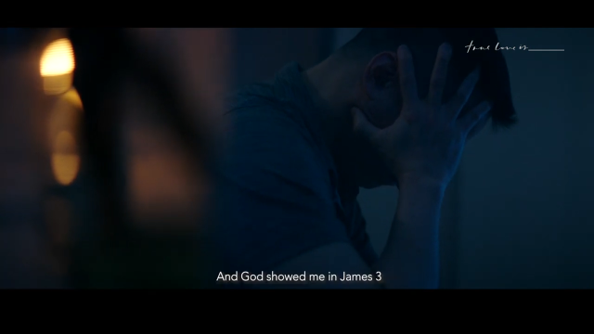
VIDEO TIME: HOW TO FOOLPROOF OUR FAITH

Slide 34
FOOLPROOF OUR FAITH
Characterisation of the Fool
1.
2.
Consequences of Faith
Confidence in God
3.

Slide 35
FOOLPROOF OUR FAITH
Characterisation of the Fool
1.
2.
Consequences of Faith
Confidence in God
3.

Slide 36
FOOLPROOF OUR FAITH
Characterisation of the Fool
1.
2.
Consequences of Faith
Confidence in God
3.

