Slide 2
Spiritual Life
Part 1 Be Spiritually Strong
Part 2 Journey in Brokenness

Slide 3
Breakout Rooms Discussion in 2s-3s:
Q1. WHAT does it mean to be spiritually strong?
Q2. WHO knows whether you are spiritually strong?
Q3. WHY should we be spiritually strong?

Slide 4
Spiritual Life
Part 1 Be Spiritually Strong
Part 2 Journey in Brokenness

Slide 5
WHAT does it mean to be spiritually strong?

Slide 6
WHAT does it mean to be spiritually strong?
Tuned to the voice of God
Growing in Faith
Strengthened in the inner-man
Growing in love for God
Praying Always
Rooted to the Word of God
Exercising Faith
Growing in measures of faith
Spending time in the Word
Strong in Spirit
Vibrant relationship with God
Connected to the Holy Spirit
Spiritually alert
Growing in your walk with God
Constantly abiding in Jesus
Exercising spiritual authority and power
Aware of the Presence of God
Loving the Church - the people of God
Boldness and courage to wisely testify of Jesus

Slide 7
WHY be spiritually strong?

Slide 8
Acts 19:11-20 (NIV)
11 God did extraordinary miracles through Paul, 12 so that even handkerchiefs and aprons that had touched him were taken to the sick, and their illnesses were cured and the evil spirits left them. 13 Some Jews who went around driving out evil spirits tried to invoke the name of the Lord Jesus over those who were demon possessed. They would say, “In the name of Jesus, whom Paul preaches, I command you to come out.” 14 Seven sons of Sceva, a Jewish chief priest, were doing this.

Slide 9
Acts 19:11-20 (NIV)
15 (One day) the evil spirit answered them, “Jesus I know, and I know about Paul, but who are you?” 16 Then the man who had the evil spirit jumped on them and overpowered them all. He gave them such a beating that they ran out of the house naked and bleeding. 17 When this became known to the Jews and Greeks living in Ephesus, they were all seized with fear, and the name of the Lord Jesus was held in high honor.

Slide 10
Acts 19:11-20 (NIV)
18 Many of those who believed now came and openly confessed their evil deeds. 19 A number who had practiced sorcery brought their scrolls together and burned them publicly. When they calculated the value of the scrolls, the total came to fifty thousand drachmas. 20 In this way the word of the Lord spread widely and grew in power.

Slide 11
HOW to be spiritually strong?

Slide 12
1. John 5:39-40: Develop an open-seeking heart towards God.
John 5:39-40 (NIV)
39 You diligently study the Scriptures because you think that by them you possess eternal life … 40 yet you refuse to come to me to have life.

Slide 13
1. John 5:39-40: Develop an open-seeking heart towards God.
A. We can come to the House of God and yet fail to meet the God of the House.
B. We can do bible studies and yet fail to experience the Word Himself.
C. We can serve in the church and yet not have a present relationship with Him.

Slide 14
1. John 5:39-40: Develop an open-seeking heart towards God.
Ephesians 1:17-18 (NIV) .. keep asking .. God .. to give you the Spirit of wisdom and revelation, so that you may know him better .. the eyes of your heart may be enlightened ..

Slide 15
1. John 5:39-40: Develop an open-seeking heart towards God.
James 1:22 But be doers of the word, and not hearers only, deceiving yourselves.

Slide 16
2. Hebrews 12:1: Deal with sins in our lives.
Hebrews 12:1 .. let us throw off everything that hinders and the sin that so easily entangles, and let us run with perseverance the race marked out for us.

Slide 17
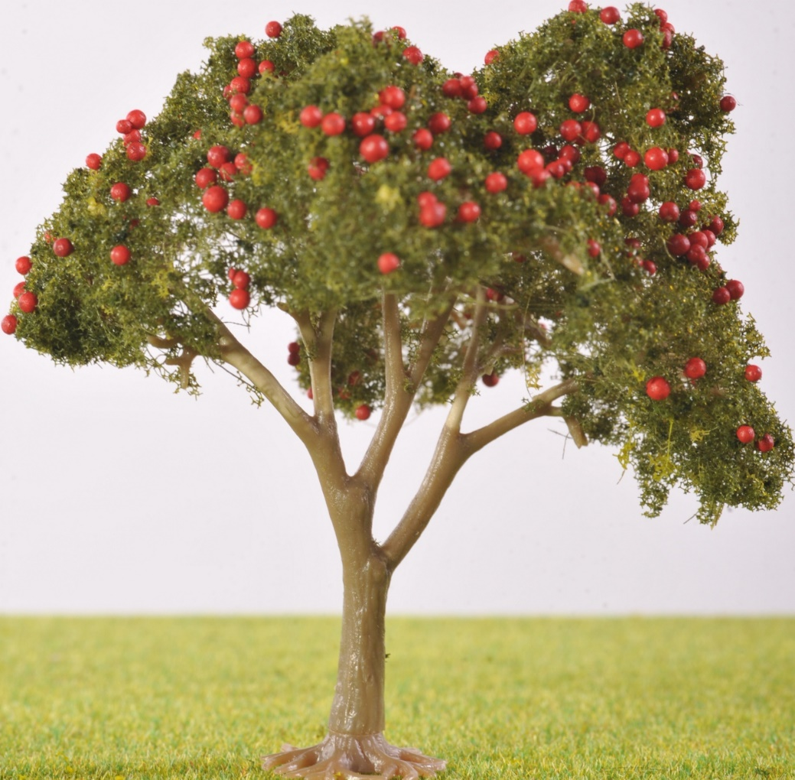
2. Hebrews 12:1: Deal with sins in our lives.
Sin and Sins
Sins
Sin

Slide 18
2. Hebrews 12:1: Deal with sins in our lives.
Galatians 5:19-21 (Sins of Commission)
19 The acts of the sinful nature are obvious: sexual immorality, impurity and debauchery; 20 idolatry and witchcraft; hatred, discord, jealousy, fits of rage, selfish ambition, dissensions, factions 21 and envy; drunkenness, orgies, and the like. I warn you, as I did before, that those who live like this will not inherit the kingdom of God.

Slide 19
2. Hebrews 12:1: Deal with sins in our lives.
James 4:17 (Sins of Omission)
Anyone, then, who knows the good he ought to do and doesn’t do it, sins.

Slide 20
2. Hebrews 12:1: 2 Remedies:
A. The Blood cleanses us from sins.
B. The Cross deals with the sin nature in us.

Slide 21
3. Hebrews 12:1: Deal with personal baggage.
Hebrews 12:1 … let us throw off everything that hinders and the sin that so easily entangles, and let us run with perseverance the race marked out for us.

Slide 22
3. Hebrews 12:1: Deal with personal baggage.
A. Unhealed Hurts
B. Unmet Needs
C. Unresolved Issues
D. Certain Relationships
E. Certain Activities

Slide 23
Living the Christian Life - The Make-up of Man
1 Thessalonians 5:23 (NIV)
May God Himself, the God of Peace sanctify you through and through. May your whole spirit, soul and body be kept blameless at the coming of our Lord Jesus Christ.

Slide 24
Living the Christian Life - The Make-up of Man
1. BODY
2. SOUL
3. SPIRIT

Slide 25
Living the Christian Life - The Make-up of Man
1. BODY
2. SOUL
3. SPIRIT
A. Dust
B. Mortal
C. 5 Senses
D. Physical Consciousness

Slide 26
Living the Christian Life - The Make-up of Man
1. BODY
2. SOUL
3. SPIRIT
A. Rest/Sleep
B. Exercise
C. Diet/Nutrition
(RED)

Slide 27
Living the Christian Life - The Make-up of Man
1. BODY
2. SOUL
3. SPIRIT
A. Hebrew: Nephesh
Greek: Psuche
Seat of Man’s Personality

Slide 28
Living the Christian Life - The Make-up of Man
1. BODY
2. SOUL
3. SPIRIT
B. 3 Main Functions:
(1) Mind
(2) Emotion
(3) Will
(MEW)

Slide 29
Living the Christian Life - The Make-up of Man
1. BODY
2. SOUL
3. SPIRIT
Hebrew: Ruach
Greek: Pneuma
Inner-most Being
Heart

Slide 30
Living the Christian Life - The Make-up of Man
1. BODY
2. SOUL
3. SPIRIT
Ruach/Pneuma
A. God- consciousness
B. Not Holy Spirit
Romans 8:16 The Spirit Himself testifies with our spirit that we are God’s children

Slide 31
Living the Christian Life - The Make-up of Man
1. BODY
2. SOUL
3. SPIRIT
Ruach/Pneuma
A. God- consciousness
B. Not Holy Spirit
C. Not Soul
Hebrews 4:12 For the Word of God is living and active. Sharper than any double-edged sword, it penetrates even to dividing soul and spirit …

Slide 32
Living the Christian Life - The Make-up of Man
1. BODY
2. SOUL
3. SPIRIT
3 Main Functions of:
(1) Relationship
(2) Conscience
(3) Discernment
(RCD)

Slide 33
Living the Christian Life - The Make-up of Man
1. BODY
2. SOUL
3. SPIRIT
Ruach/Pneuma
3 Main Functions of
(1) Our Relationship with God
2 Corinthians 13:14 May the grace of the Lord Jesus Christ, and the love of God, and the fellowship of the Holy Spirit be with you all.

Slide 34
Living the Christian Life - The Make-up of Man
1. BODY
2. SOUL
3. SPIRIT
Ruach/Pneuma
3 Main Functions of
(2) Our Conscience
Romans 9:1 I tell the truth in Christ, I am not lying, my conscience also bearing me witness in the Holy Spirit …

Slide 35
Living the Christian Life - The Make-up of Man
1. BODY
2. SOUL
3. SPIRIT
Ruach/Pneuma
3 Main Functions of
(3) Our Discernment
Hebrews 5:14 But solid food belongs to those who are of full age, that is, those who by reason of use have their senses exercised to discern both good and evil.

Slide 36
God’s Order for Christian Living
WORLD
Outer-man
Inner-man
1. BODY
Flesh SOUL Self-life
Mind
Emotion
Will
SPIRIT
Relationship
Conscience
Discernment

Slide 37
Pray for one another
James 5:16 Confess your trespasses to one another, and pray for one another, that you may be healed. The effective, fervent prayer of a righteous man avails much.

