Slide 1


Slide 2
Spiritual Life
Part I - Be Spiritually Strong
Part II - Journey in Brokenness

Slide 3


God’s Order for Christian Living
WORLD
Outer-Man
Inner-Man
BODY
Flesh SOUL
Self-life
Mind
Emotion
Will
SPIRIT
Relationship
Conscience
Discernment

Slide 4
Spiritual Life
Part I - Be Spiritually Strong
Part II - Journey in Brokenness

Slide 5

1. Know that we are a Mixture.
A. There is the Natural Life (1 Corinthians 3:1-3).
          Sinful Nature
          Old Man
          Corrupt
          Soulish - Self-Life
          Carnal Flesh
          Spiritual Infancy

Slide 6
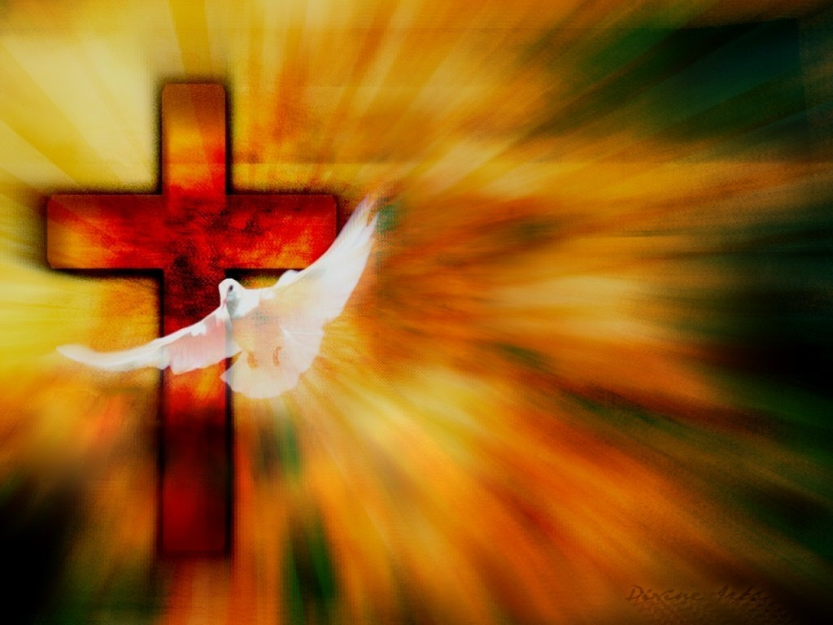
1. Know that we are a Mixture.
B. And there is the Spiritual Life.
          Christ Jesus in us.
          The Holy Spirit dwelling in us.
          Father God dwelling with us.

Slide 7
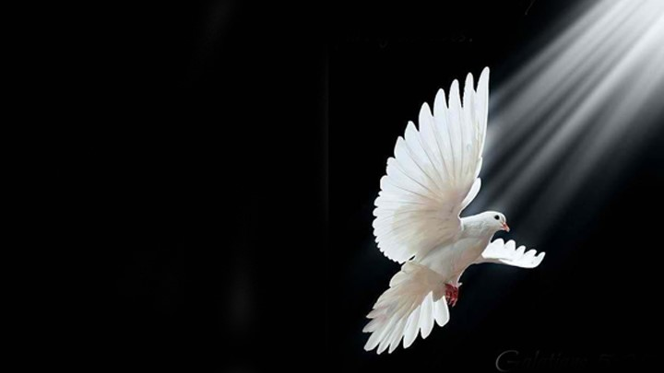
1. Know that we are a Mixture.
Galatians 5:16, 18, 25 We are to walk, live, be led, keep in step with the Spirit …
Galatians 5:17 But the Flesh in us is contrary to the ways of the Spirit.
The resulting “Tension - Battle”
to live the Christ Life - be Spirit-Led

Slide 8

Journey in Brokenness
Example of CEO
Examples of Moses & Jacob
John 12:24; Psalm 51:17; Isaiah 57:15

Slide 9
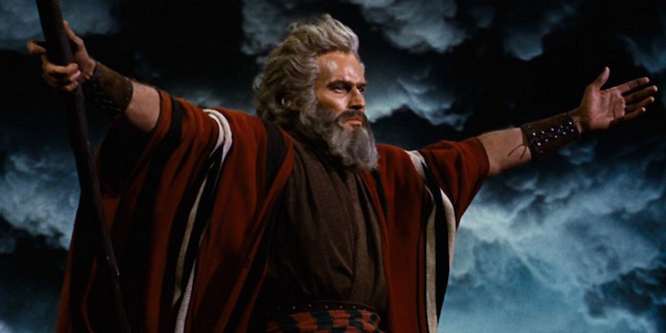
Example: Moses [at 40 years]
Acts 7:22 And Moses was learned in all the wisdom of the Egyptians,
and was mighty in words and deeds.

Slide 10
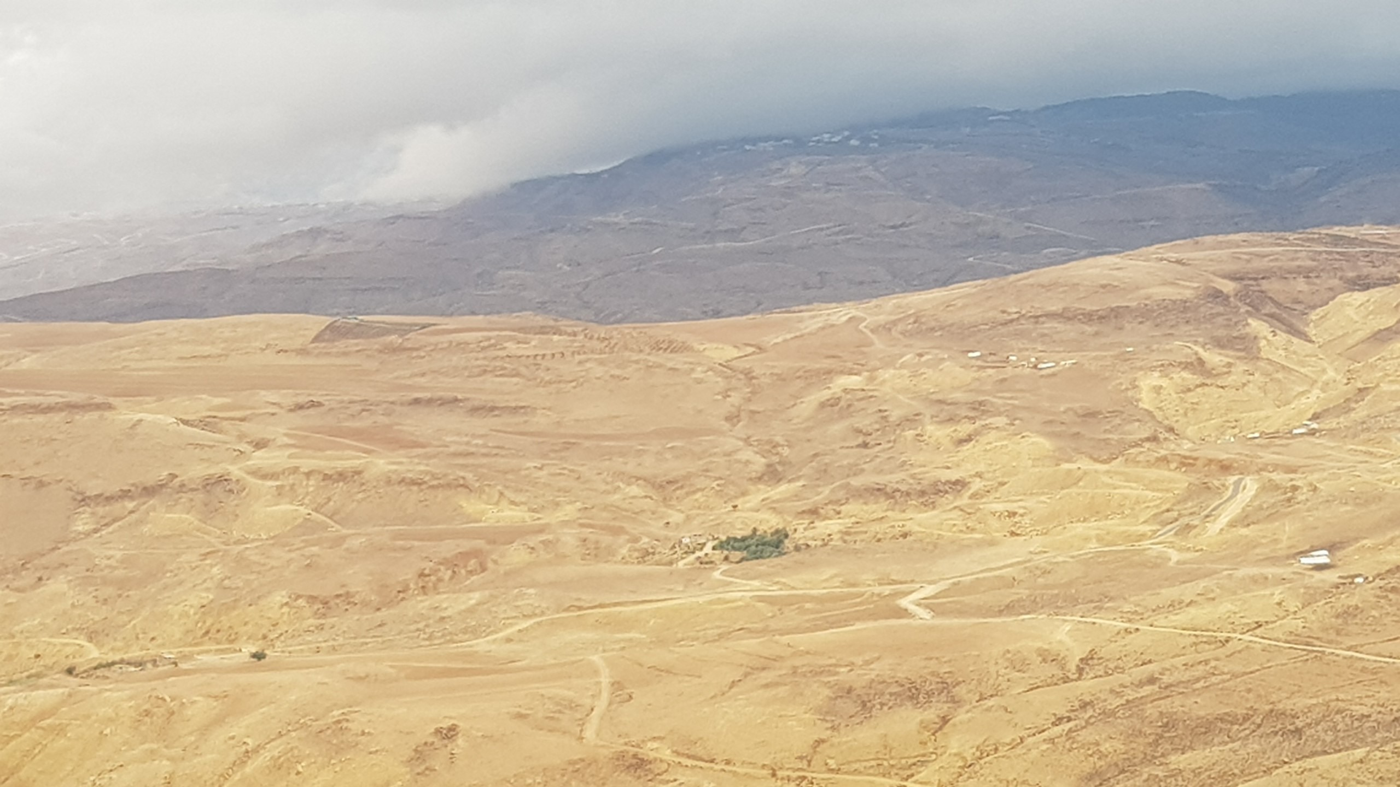
Example: Moses [During the 40 years in the wilderness]
Moses’ self-confidence was stripped …
Moses’ anger, resentment, hostility towards the Egyptians
was weeded out.
Moses’ self-determination to liberate the Jews collapsed.

Slide 11
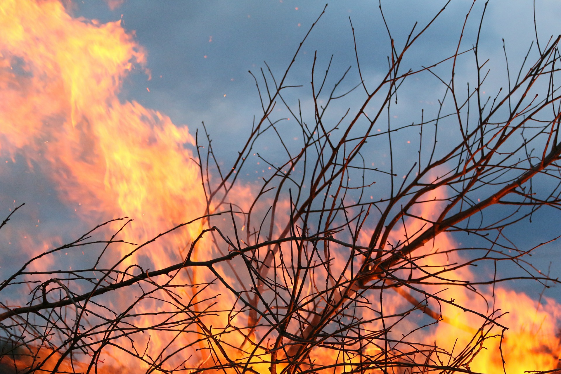
Example: Moses [At 80 years]
Moses encountered God at the burning bush …
a “broken” man.
WHO AM I?

Slide 12
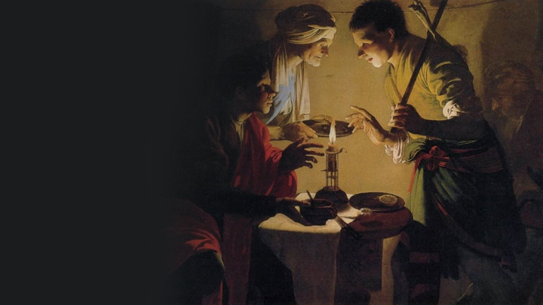
Example: Jacob
[Genesis 31:38-41]
He was a schemer, supplanter, deceiver.
This began in the mother’s womb when
he first struggled with his brother.
Cheated his brother, Esau of his birthright.

Slide 13
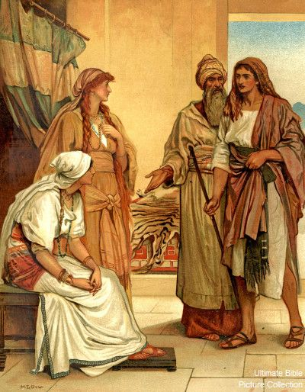
Example: Jacob
[Jacob’s Journey in Brokenness]
Jacob encountered Laban
Wages changed 10 times.
Leah instead of Rachel first.
20 years under Laban.

Slide 14
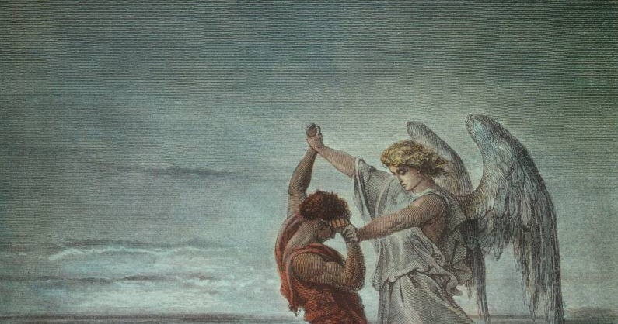
Example: Jacob [Jacob’s Journey in Brokenness]
Jacob encountered God [Genesis 32]
The wrestling with the angel, his hip was out of joint.
Jacob became a broken man.
His name was changed to Israel.
He walked with a limp.
Later he arose to bless Pharaoh
[Genesis 47].

Slide 15
Journey in Brokenness
Examples of Peter & Paul

Slide 16
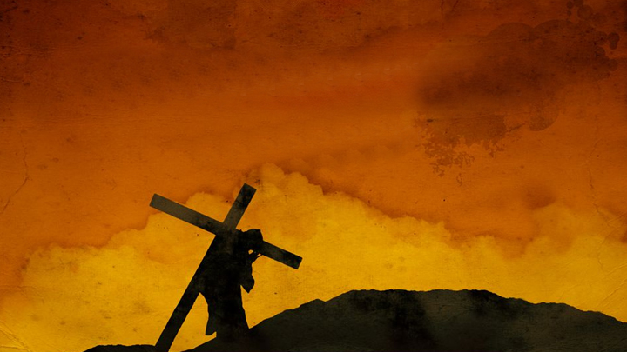
2. Daily journey in brokenness as per Luke 9:23
Then He said to them all, “If anyone desires to come after Me, let him deny himself, and take up his cross daily, and follow Me.

Slide 17
2. Brokenness - the molding of our faculties - occur as we:
A. Deny our self-life.
B. Take up our own cross daily.
C. Follow Me.

Slide 18
2. Brokenness - the molding of our faculties - occur as we:
A. Deny our self-life.
B. Take up our own cross daily.
C. Follow Me.

Slide 19

A. Deny our self-life. Our self-life:
Our Self-justification
Our Ways
Our Cleverness
Our Forceful Will
Our Low Self-image
Our Insecurity
Our Self-love
Our Opinions
Cannot Control our Tongue
Our Deep Emotion
Our Strong-minds
Our Human Arguments
Cannot Stop Comparing ourselves Better than Others
Cannot Stop Boasting in our Flesh
Cannot Keep a Rein on our Critical Spirit
Continue in Jealousy and Envy
Cannot Stop Beating ourselves Down into Self-pity

Slide 20
A. Deny our self-life.
Romans 6:11 Likewise you also, reckon yourselves to be dead indeed to sin
(the sinful nature) but alive to God in Christ Jesus our Lord.
i.e. Do not react; do not respond
according to the sinful nature.
e.g. 1 - taking revenge
e.g. 2 - keeping a record of wrongs
e.g. 3 - nursing offenses
e.g. 4 - vicarious anger

Slide 21
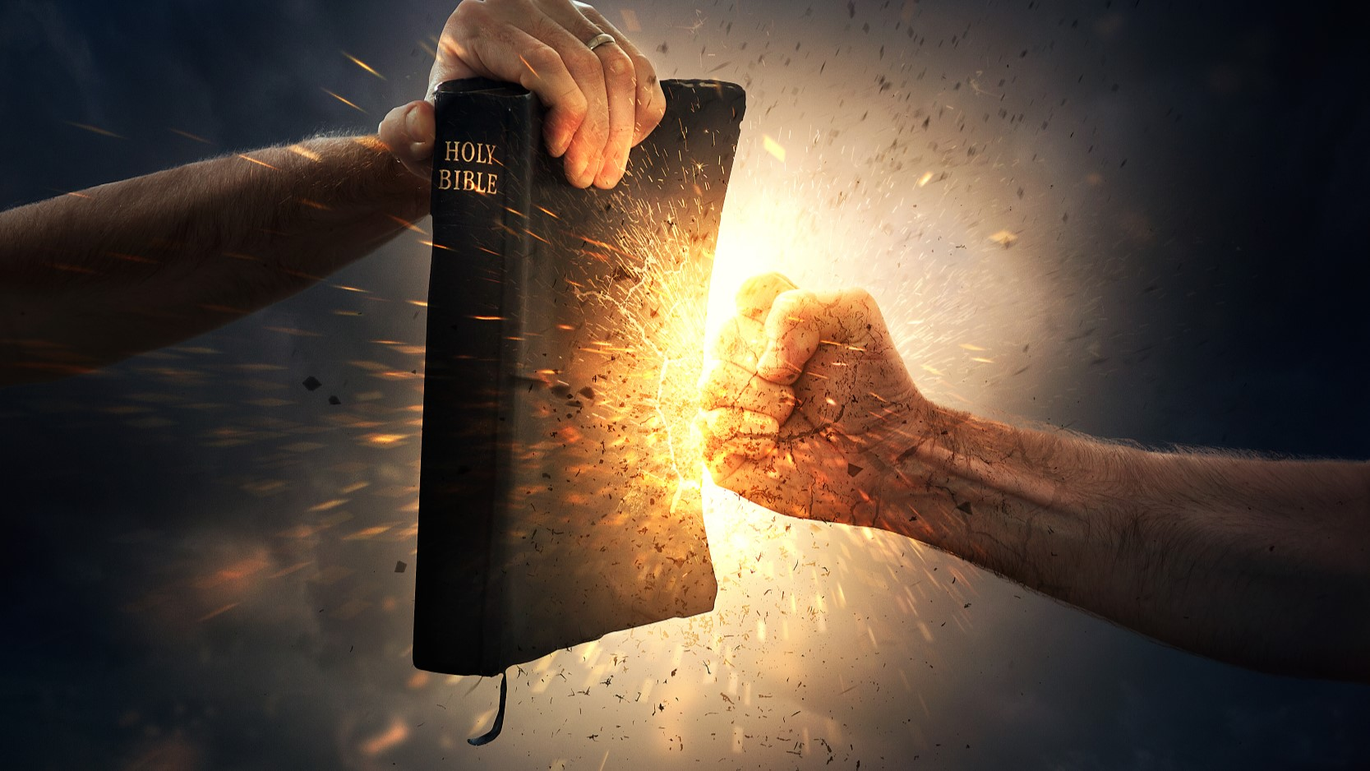
WHY
must the flesh-sin nature in us die?

Slide 22
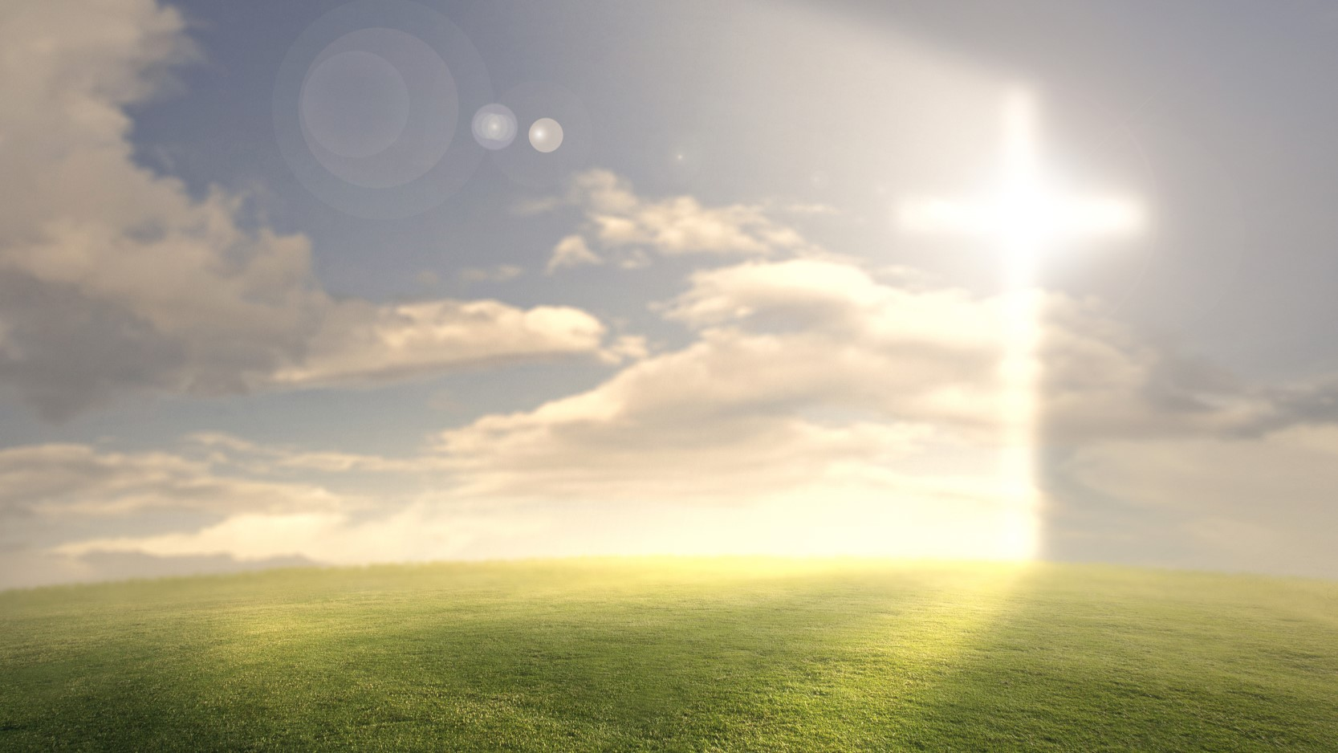

WHY must the flesh-sin nature in us die?
(1) This is because the flesh is hostile to God and cannot please God (Romans 8:7-8).
(2) The flesh profits nothing (John 6:63).
(3) The sin nature is corrupt and cannot be transformed.
The sin nature must be crucified and put to death!
HOW

Slide 23
2. Brokenness - the molding of our faculties - occur as we:
A. Deny our self-life.
B. Take up our own cross daily.
C. Follow Me.

Slide 24
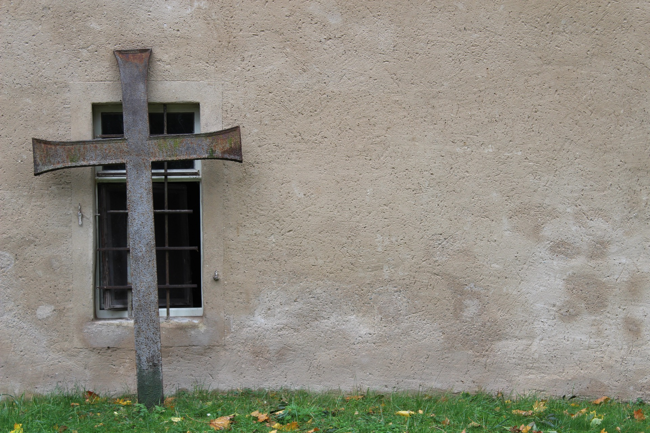
B. Take up our own cross daily.
(1) The cross means crucifixion and death
to our self-life.
(2) Our cross is not the Cross of Christ.
(3) Our cross is not our sister’s or brother’s cross.
(4) Our cross is unique and a personal one.

Slide 25
B. Take up our own cross daily.
(5) The instruments of our cross are:
(A) The people that cross our paths.
(B) The circumstances that we are in; that invokes the sin-nature in us
which must be crucified and dead.

Slide 26
The life of Christ is increased (manifested) to
the extent - degree I-ME-MYSELF is decreased.
Each time I fail to take up my cross is the time I:
Lose my temper
Fall into sin
Get Offended
Overly stressed
Get impatient
Be envious
Fight
Lust
Gossip
Quarrel
Get angry
Become fearful

Slide 27
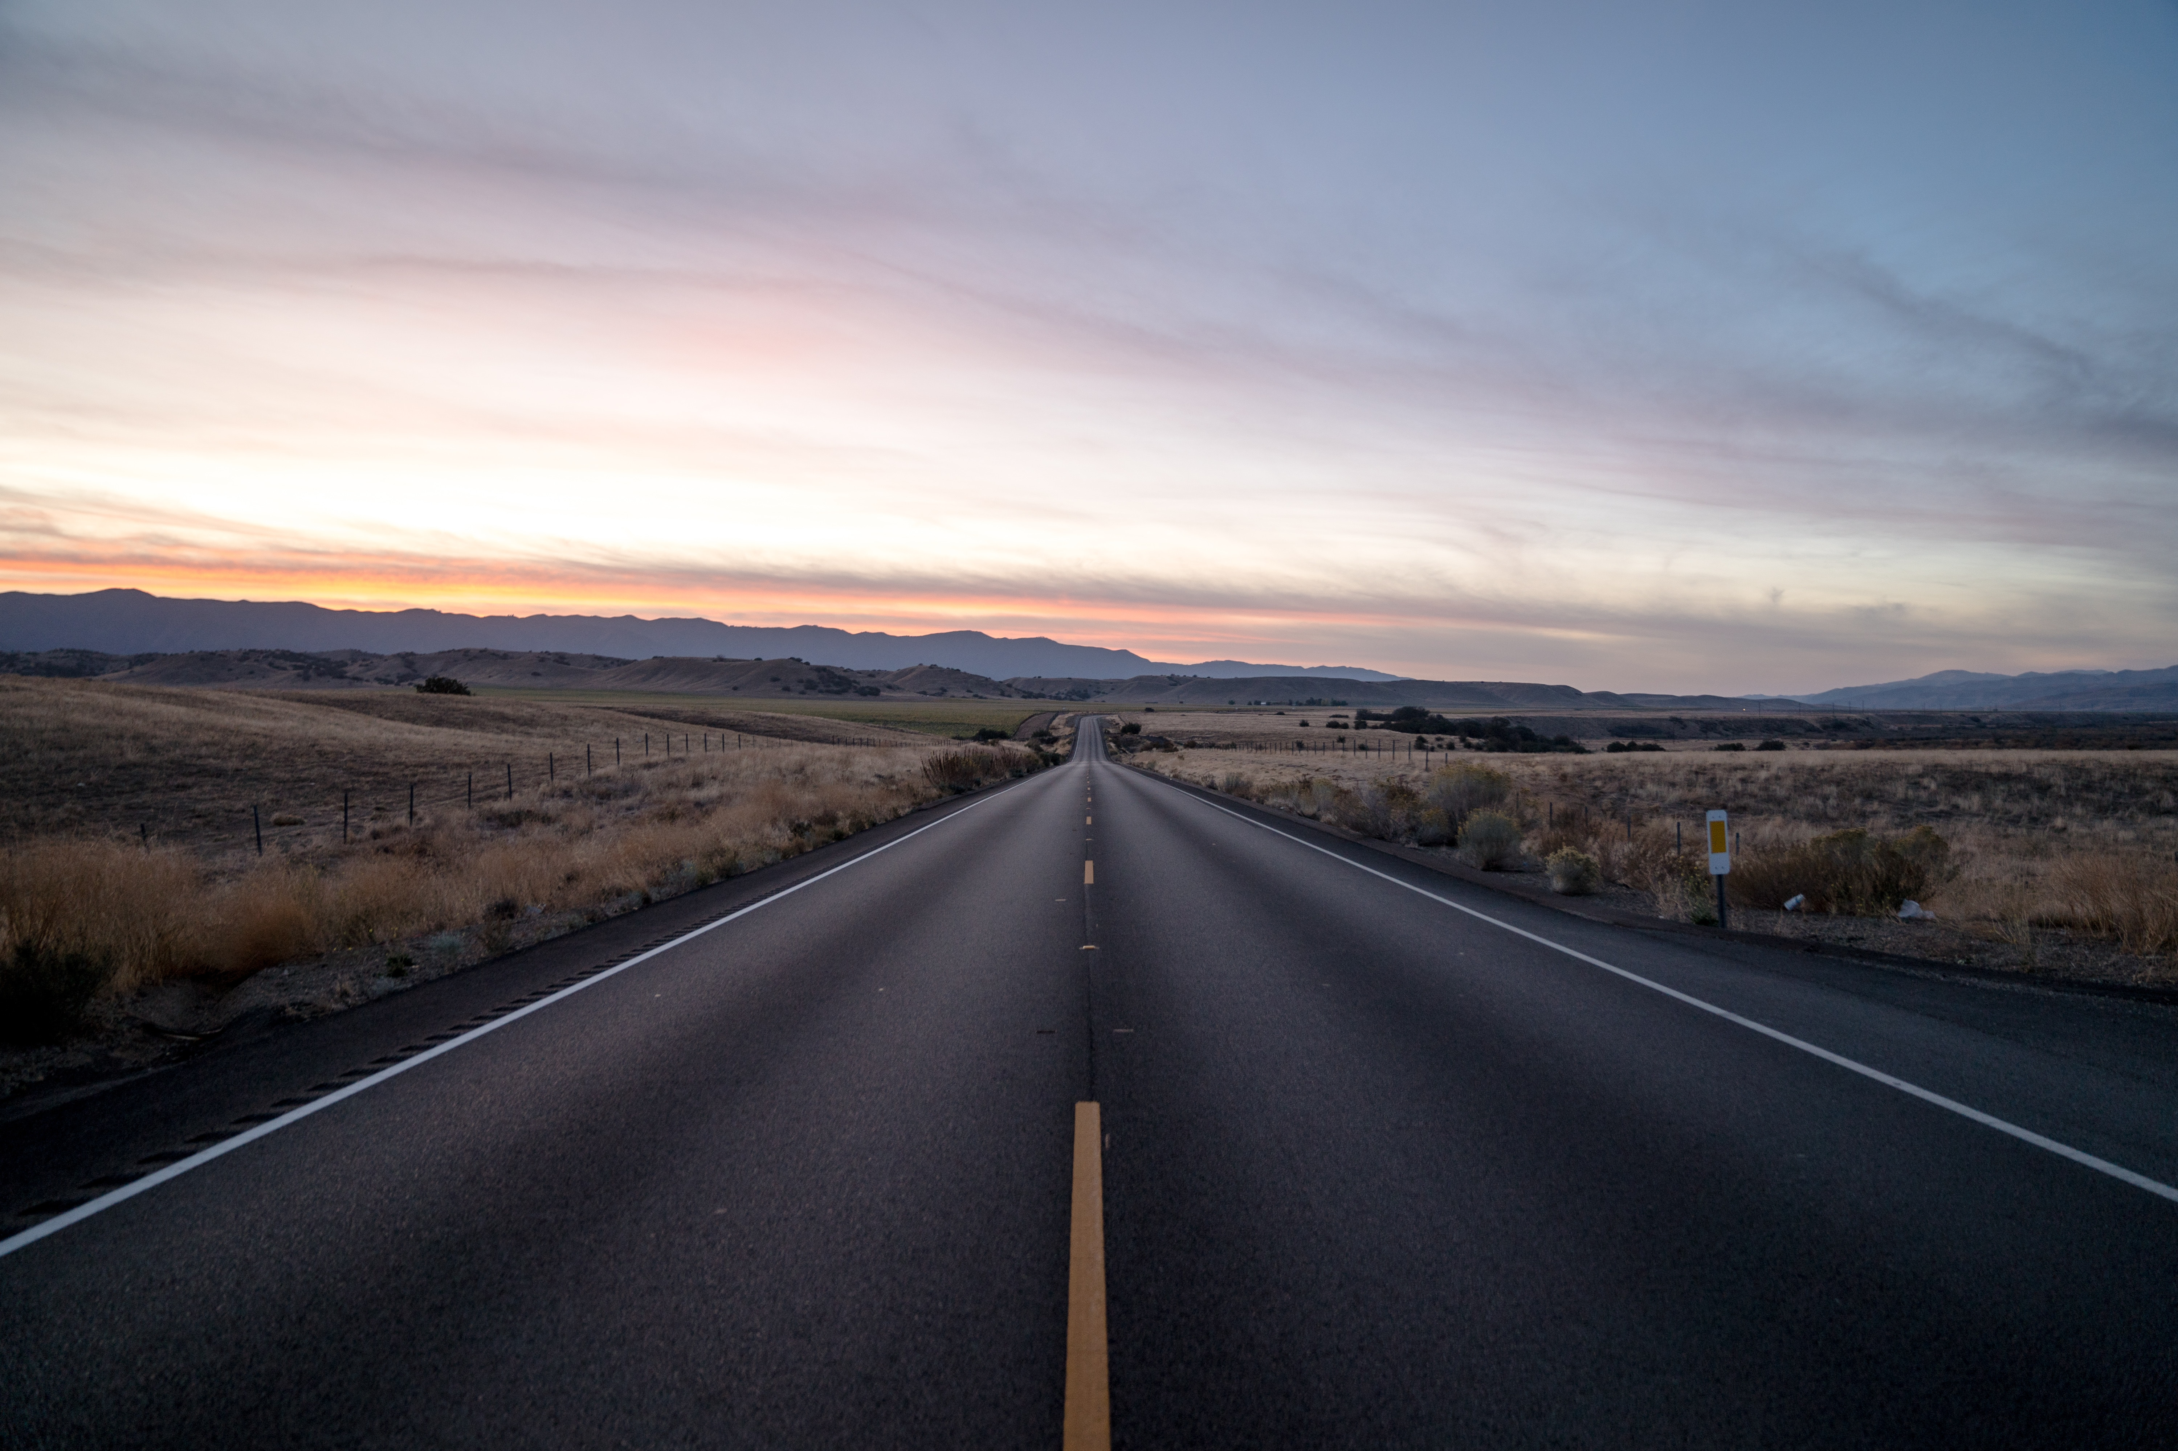
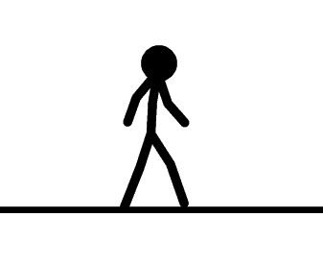
Journey in spiritual maturity to be overcomers.
Natural Man
Carnal Believer
Spiritual Believer
100
0
50
Overcomer Zone
Born again

Slide 28
2. Brokenness - the molding of our faculties - occur as we:
A. Deny our self-life.
B. Take up our own cross daily.
C. Follow Me.

Slide 29
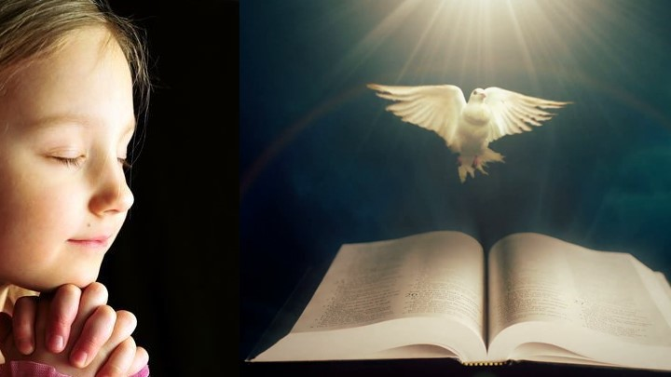
C. Follow Me [the Lord Jesus].
A journey of devotion to Christ.
This means:
We bring all our plans, thoughts,
decisions, ideas, responses …
(1) Under the authority of the Word.
(2) Under the leading of the Holy Spirit.

Slide 30

Journey in Brokenness
This is also the application of
    Proverbs 3:5-6
    5 Trust in the Lord with all your heart
    and lean not on your own understanding;
    6 in all your ways acknowledge him,
    and he will make your paths straight.

Slide 31
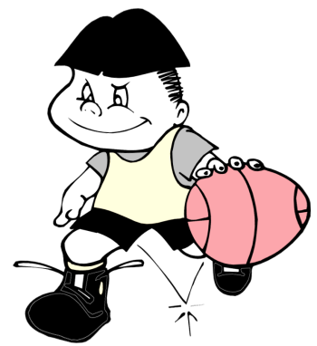

Journey in Brokenness
This is also the application of the Law of Spirit of Life over the law of sin and death (Romans 7 & 8).
Law of Sin & Death
Law of the Mind
Law of Spirit of Life
Law of Aerodynamics
Law of Gravity
Law of Will

Slide 32
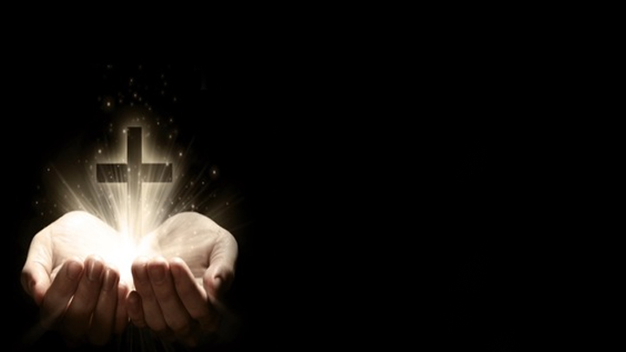
Journey in Brokenness
Galatians 2:20 I have been crucified with Christ;
it is no longer I who live, but Christ lives in me;
and the life which I now live in the flesh I live
by faith in the Son of God, who loved me and gave Himself for me.

Slide 33
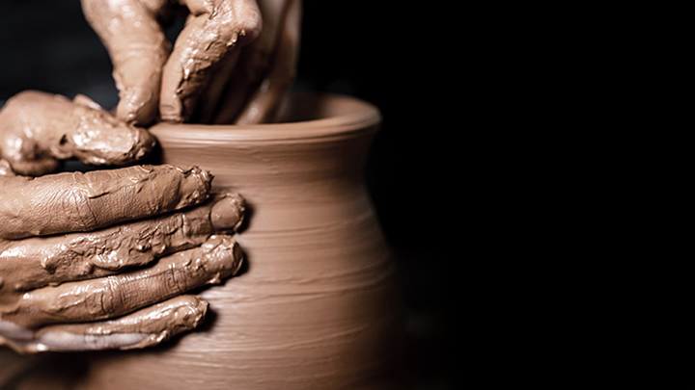
Journey in Brokenness
The Christian life is a life of
becoming more and more
like the Lord Jesus Christ
It is allowing the life of the Lord Jesus
to manifest through us.

Slide 34
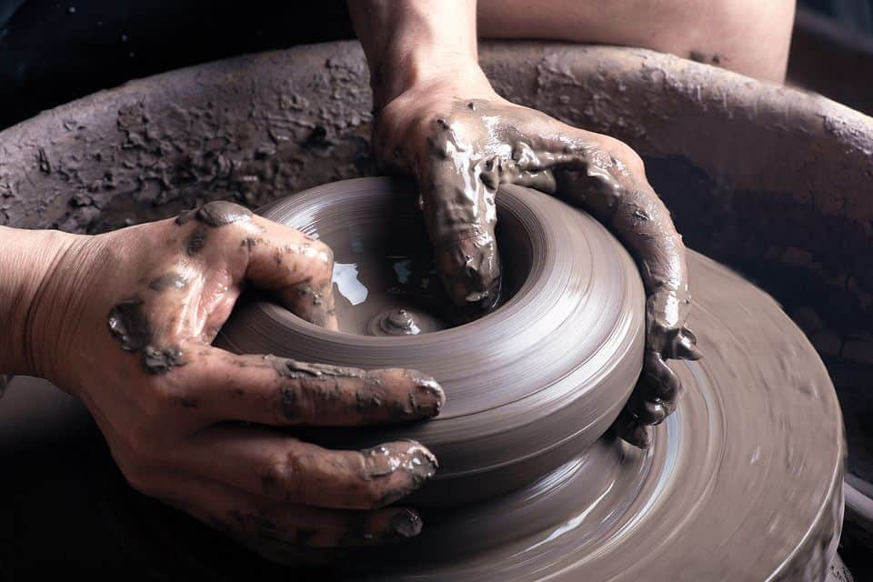
Journey in Brokenness
3. Fruit of Brokenness
- The transformation of our Soul-Personality towards Christ-likeness.
Romans 8:29 For whom He foreknew,
He also predestined to be conformed
to the image of His Son, that He might
be the firstborn among many brethren.

Slide 35
Journey in Brokenness - The transformation of our Personality
Soul-Personality
Mind
Emotion
Will
(MEW)

Slide 36
Journey in Brokenness - The transformation of our Personality
Soul-Personality
(A1) Natural Mind
Cynicism
argumentative
Suspicious
stubbornness
human wisdom of the world
cleverness
Skeptical
not willing to yield
mindset full of self
opinionated

Slide 37
Journey in Brokenness - The transformation of our Personality
Soul-Personality
(A2) Renewed Mind
i. Our mind must be daily renewed after the mind of Christ.
Romans 12:1-2; Philippians 2:5; 1 Corinthians 2:16

Slide 38
Journey in Brokenness - The transformation of our Personality
Soul-Personality
(B1) Natural Emotion
jealously
strife
fits of rage
envy
Cannot rejoice with other’s success
easily swayed
mood swings
lusts
impatience
feelings
Need to boast / defend self vs have nothing to prove

Slide 39
Journey in Brokenness - The transformation of our Personality
Soul-Personality
(B2) Spirit-led Emotion
ii. Our emotions must be surrendered to the Holy Spirit.
He will temper our emotions … to manifest the fruit of the Spirit … (Galatians 5:22-23)

Slide 40
Journey in Brokenness - The transformation of our Personality
Soul-Personality
(C1) Natural Will
prejudiced
uninformed
Stubborn
unenlightened
not wise
biased
reaction from hurts
foolish
not according to the Word,
the Will, the Way and Wisdom of God

Slide 41
Journey in Brokenness - The transformation of our Personality
Soul-Personality
(C2) Will aligned with God
iii. Our will must be aligned with God.
We then have the knowledge, spiritual wisdom and spiritual understanding to make correct enlightened decision and choices (Colossians 1:9-10)

Slide 42
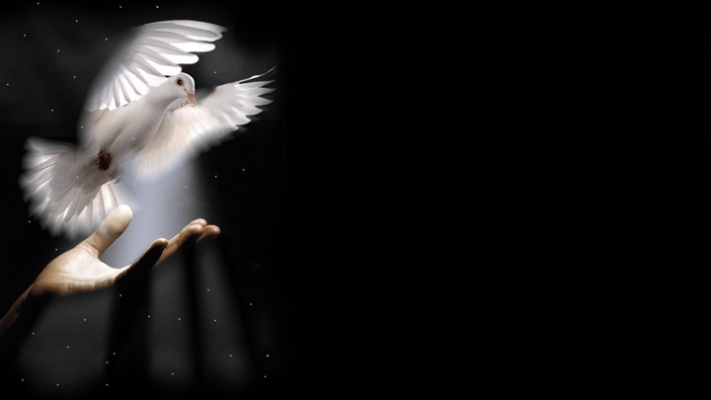
Journey in Brokenness
4. Strengthen our Spirit-Man.
Luke 1:80 So the child grew and became strong in spirit, and was in the deserts till the day of his manifestation to Israel.
Luke 2:40 And the Child grew and became strong in spirit, filled with wisdom; and the grace of God was upon Him.
Ephesians 3:16

Slide 43
We strengthen our spirit-man by developing the 3 main faculties
of our spirit:
1. BODY
2. SOUL
3. SPIRIT
3 main functions of
(1) Relationship
(2) Conscience
(3) Discernment
(RCD)

Slide 44
God’s Order for Christian Living
WORLD
Outer-Man
Inner-Man
BODY
Flesh SOUL
Self-life
Mind
Emotion
Will
SPIRIT
Relationship
Conscience
Discernment

Slide 45
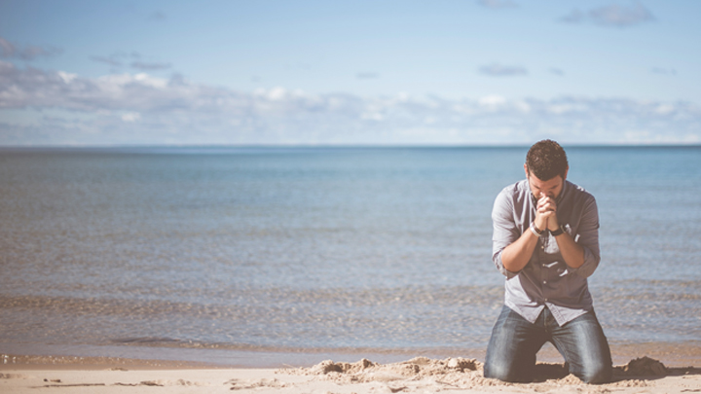
Summary Conclusion
I. We must repent of living our lives carnally i.e. in the Flesh
rather than by the Spirit.
Know the Mixture in us

Slide 46
Summary Conclusion
II. We must Surrender our lives to God totally to live
in utter dependency on Him.
Then we will be changed and be transformed
into the image of Christ.

Slide 47
Spiritual Life
Part I - Be Spiritually Strong
Part II - Journey in Brokenness

