Slide 1


Slide 2


Slide 3
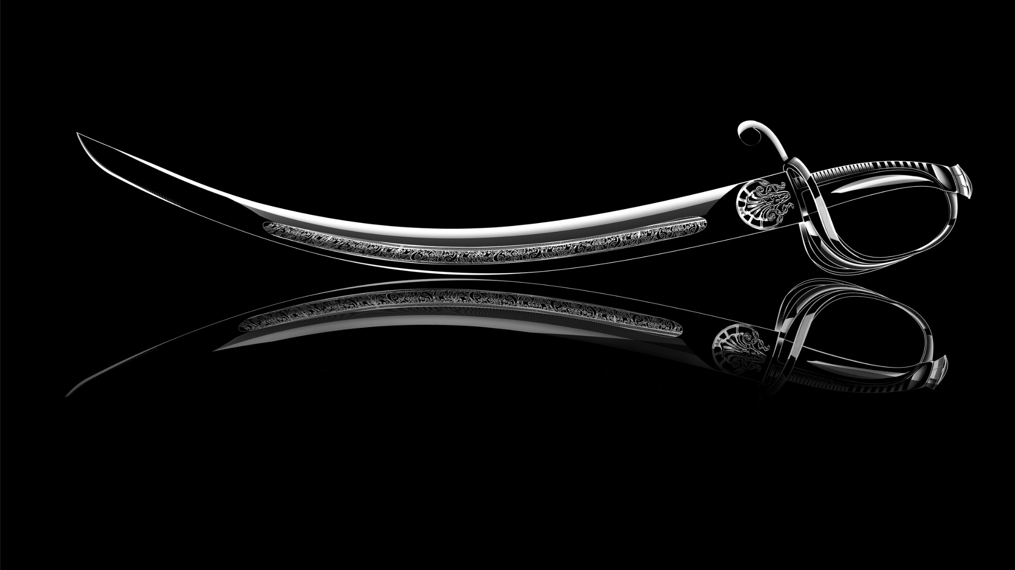
The Word of God is:
The Sword of the Spirit
Ephesians 6:17
AND
The Double-Edged Sword
Psalm 149:6 Hebrews 4:12 Revelation 2:12

Slide 4
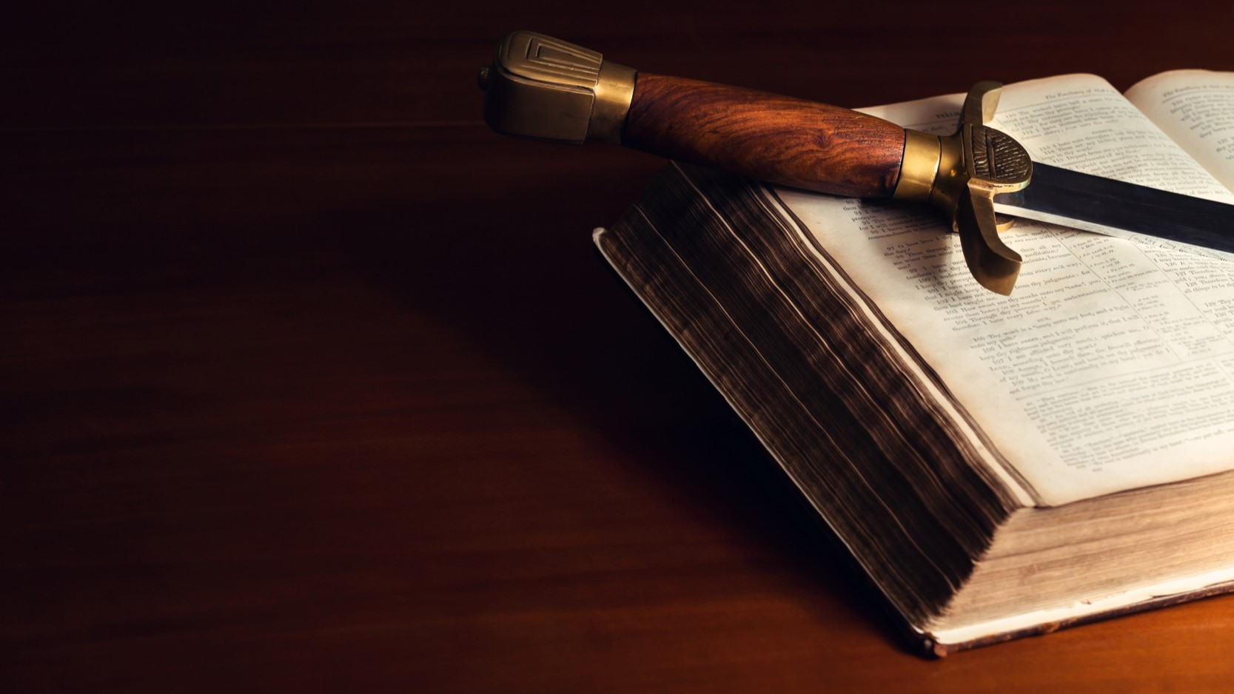
Double-Edged Sword in our hands
equals to
Building a Strong Word-Life
Working Knowledge
of the Double-edged Sword
Wielding the Sword of the Spirit
Word-Empowered Believer

Slide 5

I. Why build a strong word-life?

Slide 6

I. Why build a strong word-life?
1. The Word strengthens my spirit-man.
John 6:63 It is the Spirit who gives life; the flesh profits nothing.
The words that I speak to you are spirit, and they are life.

Slide 7

I. Why build a strong word-life?
2. The Word makes my way prosperous.
Joshua 1:8 Do not let this Book of the Law depart from your mouth; meditate on it day and night, so that you may be careful to do everything written in it. Then you will be prosperous and successful.

Slide 8

I. Why build a strong word-life?
2. The Word makes my way prosperous.
Psalm 1:1-3
1 Blessed is the man … 2 [whose] delight
is in the law of the LORD, and in His law
he meditates day and night. 3 He shall be like a tree planted by the rivers of water,
that brings forth its fruit in its season, whose leaf also shall not wither; and whatever he does shall prosper.

Slide 9

I. Why build a strong word-life?
3. The Word is revelation for direction and decisions in life.
John 1:1, 4
1 In the beginning was the Word, and the Word was with God, and the Word
was God. 4 In Him was life, and the life was the light of men.
Psalm 119:105 Your word is a lamp to my feet and a light to
my path.

Slide 10

I. Why build a strong word-life?
4. Because it is life and health to us.
Proverbs 4:20-22
20 My son, give attention to my words; incline your ear
to my sayings. 21 Do not let them depart from your eyes; keep them in the midst of your heart; 22 for they are life to those who find them, and health to all their flesh.

Slide 11

I. Why build a strong word-life?
5. The Word is power to restrain me from sin.
Psalm 119:11 Your Word I have hidden in my heart, that I might not sin against You.

Slide 12

I. Why build a strong word-life?
6. The Word is wisdom and revelation to me.
Psalm 119:98-100
98 Wiser than enemies
99 More insight than all my teachers
100 More understanding than the elders

Slide 13

I. Why build a strong word-life?
7. The Word is my spiritual weapon.
Revelation 12:11 They overcame him by the blood of the Lamb and
by the word of their testimony; they did not love their lives so much
as to shrink from death.
Ephesians 6:17 Take the helmet of salvation and
the sword of the Spirit, which is the word of God.

Slide 14
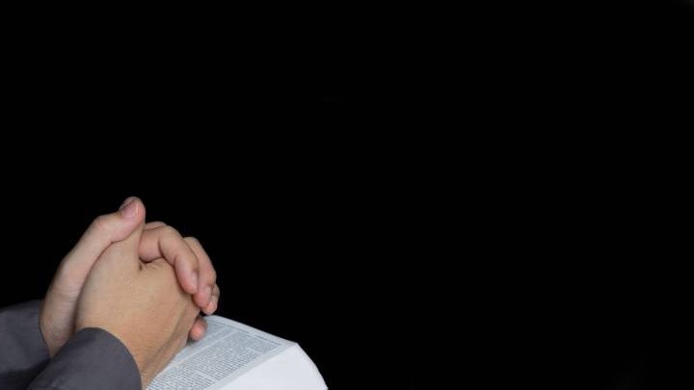
I. Why build a strong word-life?
8. The Word is key to answered prayer.
John 15:7 If you abide in Me, and My words abide in you, you will ask what
you desire, and it shall be done for you.
God always fulfil His Word.

Slide 15
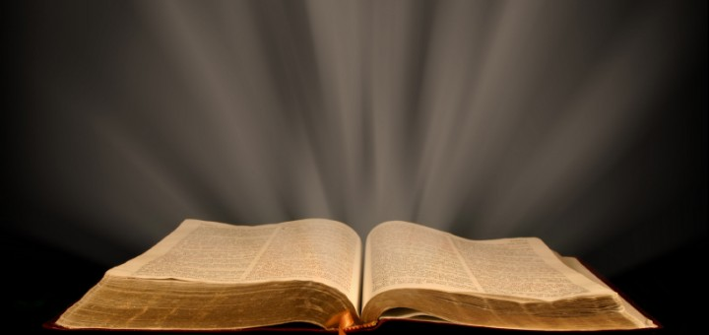
I. Why build a strong word-life?
8. The Word is key to answered prayer.
Psalm 138:2 …for You have magnified Your word above all Your name.

Slide 16
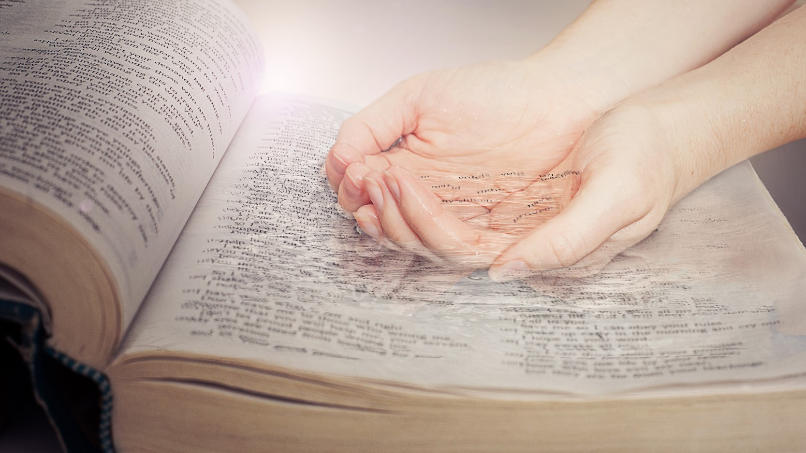
I. Why build a strong word-life?
9. The Word is key to an abundant life.
Proverbs 18:21 Death and life are in the power of the tongue, and those who love it will eat its fruit.

Slide 17

I. Why build a strong word-life?
10. A command of God.
Colossians 3:16 Let the Word of God dwell richly in you.
Proverbs 3:3 Let not mercy and truth forsake you; bind them around your neck, write them on the tablet of your heart.
Proverbs 7:3 Bind them on your fingers; write them on the tablet of your heart.

